Slide 1
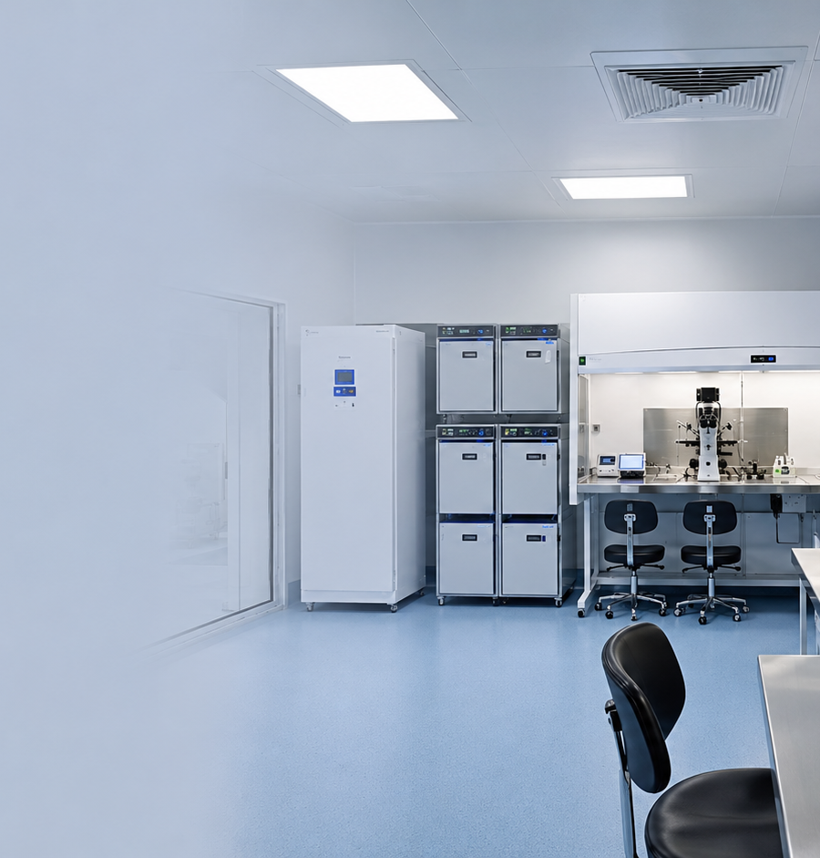
INSIDE EMBRYO BY AURION
IVF Laboratory Design
Complete Foundation Presentation
Introduction and core concepts for beginner learners
Beginner
Major category
Embryology and IVF Laboratory Science
Subcategory: IVF Laboratory Science and Procedures
Author: Manoj Kumar K
Presentation date: 10 August 2026
Premium ART & embryology knowledge product
[1–4]
Notes:
Speaker notes:
This opening slide positions IVF laboratory design as a specialist foundation topic in assisted reproductive technology. For a beginner, the key idea is that a laboratory is not only a room with equipment. It is a controlled biological environment built to support safe handling of gametes, embryos, samples, staff workflow and documentation.
Slide-production table row:
Slide number: 1 | Slide title: Premium title slide | Learning purpose: Orient the learner and establish the topic, level and brand identity. | Exact on-slide text: IVF Laboratory Design; Complete Foundation Presentation; Introduction and core concepts for beginner learners; Beginner; Major category; Subcategory; Author; Presentation date; Premium ART & embryology knowledge product. | Layout description: Left text block with right realistic IVF laboratory hero image and gold divider. | Required visual: Large realistic modern IVF laboratory image. | Exact AI-image prompt: Create a scientifically accurate, high-resolution medical illustration of a modern IVF laboratory cleanroom interior with microscopes, incubators and workstations. Use realistic laboratory detail, soft clinical lighting, clean blue-grey scientific background and negative space. No text, labels, watermarks or fantasy elements. 16:9. | Speaker notes: This opening slide positions IVF laboratory design as a specialist foundation topic in assisted reproductive technology. For a beginner, the key idea is that a laboratory is not only a room with equipment. It is a controlled biological environment built to support safe handling of gametes, embryos, samples, staff workflow and documentation. | Slide citation: [1–4]

Slide 2
Why IVF laboratory design matters
Inside Embryo by Aurion
2
Why this topic matters
Design choices influence safety, stability and laboratory discipline.
Protects gametes and embryos
Reduces preventable risk
Supports consistent outcomes
Oocytes, sperm and embryos are handled outside the body, so exposure time, temperature, pH and air quality must be controlled.
Good layout separates clean work, support tasks, storage, staff movement and documentation to reduce contamination and mix-up risk.
Stable design supports standard operating procedures, equipment monitoring, witnessing and quality management.
Embryo safety
Workflow clarity
Quality culture
Takeaway: IVF lab design is a patient-safety and embryo-culture issue—not interior decoration.
Inside Embryo by Aurion • Beginner • IVF Laboratory Science and Procedures
[1–5]
Notes:
Speaker notes:
IVF laboratory design matters because the laboratory temporarily replaces some protective conditions of the reproductive tract. It also creates the workflow that staff will follow under time pressure. A good design helps embryos, staff and records move through predictable paths. It cannot guarantee pregnancy, but it can reduce avoidable environmental variation and preventable operational risk.
Slide-production table row:
Slide number: 2 | Slide title: Why this topic matters | Learning purpose: Explain the relevance of laboratory design in ART and embryology practice. | Exact on-slide text: Protects gametes and embryos. Reduces preventable risk. Supports consistent outcomes. Takeaway: IVF lab design is a patient-safety and embryo-culture issue—not interior decoration. | Layout description: Three relevance cards with bottom takeaway bar. | Required visual: Three concise relevance cards with icon-like pills. | Exact AI-image prompt: No AI image required; editable PowerPoint cards and icon-style labels. | Speaker notes: IVF laboratory design matters because the laboratory temporarily replaces some protective conditions of the reproductive tract. It also creates the workflow that staff will follow under time pressure. A good design helps embryos, staff and records move through predictable paths. It cannot guarantee pregnancy, but it can reduce avoidable environmental variation and preventable operational risk. | Slide citation: [1–5]

Slide 3
Learning objectives
Inside Embryo by Aurion
3
Learning objectives
By the end, the learner should be able to:
1
Define IVF laboratory design in simple scientific language.
2
Identify key laboratory zones and micro-environments.
3
Explain why air quality and workflow matter.
4
Recognise common design terminology.
5
Avoid beginner misconceptions about IVF lab setup.
Focus: foundation concepts, not legal design approval or clinic-specific protocol writing.
Inside Embryo by Aurion • Beginner • IVF Laboratory Science and Procedures
None
Notes:
Speaker notes:
These objectives keep the presentation practical and beginner-friendly. The learner should first understand the language of IVF laboratory design before thinking about advanced engineering specifications. The session focuses on concepts: what areas are needed, why they exist, how they interact and what mistakes beginners often make when they imagine an IVF laboratory as a normal clinical room.
Slide-production table row:
Slide number: 3 | Slide title: Learning objectives | Learning purpose: Set measurable learning outcomes for beginner learners. | Exact on-slide text: Define IVF laboratory design in simple scientific language. | Identify key laboratory zones and micro-environments. | Explain why air quality and workflow matter. | Recognise common design terminology. | Avoid beginner misconceptions about IVF lab setup. | Focus: foundation concepts, not legal design approval or clinic-specific protocol writing. | Layout description: Numbered objective list with a bottom scope note. | Required visual: Editable numbered objective list. | Exact AI-image prompt: No AI image required; editable PowerPoint text and numbered markers. | Speaker notes: These objectives keep the presentation practical and beginner-friendly. The learner should first understand the language of IVF laboratory design before thinking about advanced engineering specifications. The session focuses on concepts: what areas are needed, why they exist, how they interact and what mistakes beginners often make when they imagine an IVF laboratory as a normal clinical room. | Slide citation: None

Slide 4
Essential terminology
Inside Embryo by Aurion
4
Essential terminology
Six words beginners must understand before discussing design.
ART
Clean area
HEPA
Assisted reproductive technology: procedures that handle gametes or embryos outside the body.
A controlled area designed to limit particles, microbes and chemical exposure.
High-efficiency particulate air filtration for airborne particles.
VOC
Positive pressure
Workflow
Volatile organic compound: airborne chemical that may come from materials or cleaning agents.
Air pressure pattern that helps push cleaner air outward.
The planned movement of people, samples, materials and records.
Takeaway: design vocabulary links engineering, embryology and quality management.
Inside Embryo by Aurion • Beginner • IVF Laboratory Science and Procedures
[1,3,4]
Notes:
Speaker notes:
Terminology is important because laboratory design discussions often mix clinical, embryology and engineering words. Beginners should not memorise these as isolated definitions. Instead, connect each term to a practical task. For example, HEPA filtration targets particles, while VOC control targets chemical contaminants. Workflow describes the path followed by samples and staff.
Slide-production table row:
Slide number: 4 | Slide title: Essential terminology | Learning purpose: Define key terms in simple language before process slides. | Exact on-slide text: ART: Assisted reproductive technology: procedures that handle gametes or embryos outside the body. | Clean area: A controlled area designed to limit particles, microbes and chemical exposure. | HEPA: High-efficiency particulate air filtration for airborne particles. | VOC: Volatile organic compound: airborne chemical that may come from materials or cleaning agents. | Positive pressure: Air pressure pattern that helps push cleaner air outward. | Workflow: The planned movement of people, samples, materials and records. | Takeaway: design vocabulary links engineering, embryology and quality management. | Layout description: Six icon-supported definition cards in a 3 × 2 grid. | Required visual: Editable definition cards with teal and gold accents. | Exact AI-image prompt: No AI image required; editable PowerPoint definition cards. | Speaker notes: Terminology is important because laboratory design discussions often mix clinical, embryology and engineering words. Beginners should not memorise these as isolated definitions. Instead, connect each term to a practical task. For example, HEPA filtration targets particles, while VOC control targets chemical contaminants. Workflow describes the path followed by samples and staff. | Slide citation: [1,3,4]

Slide 5
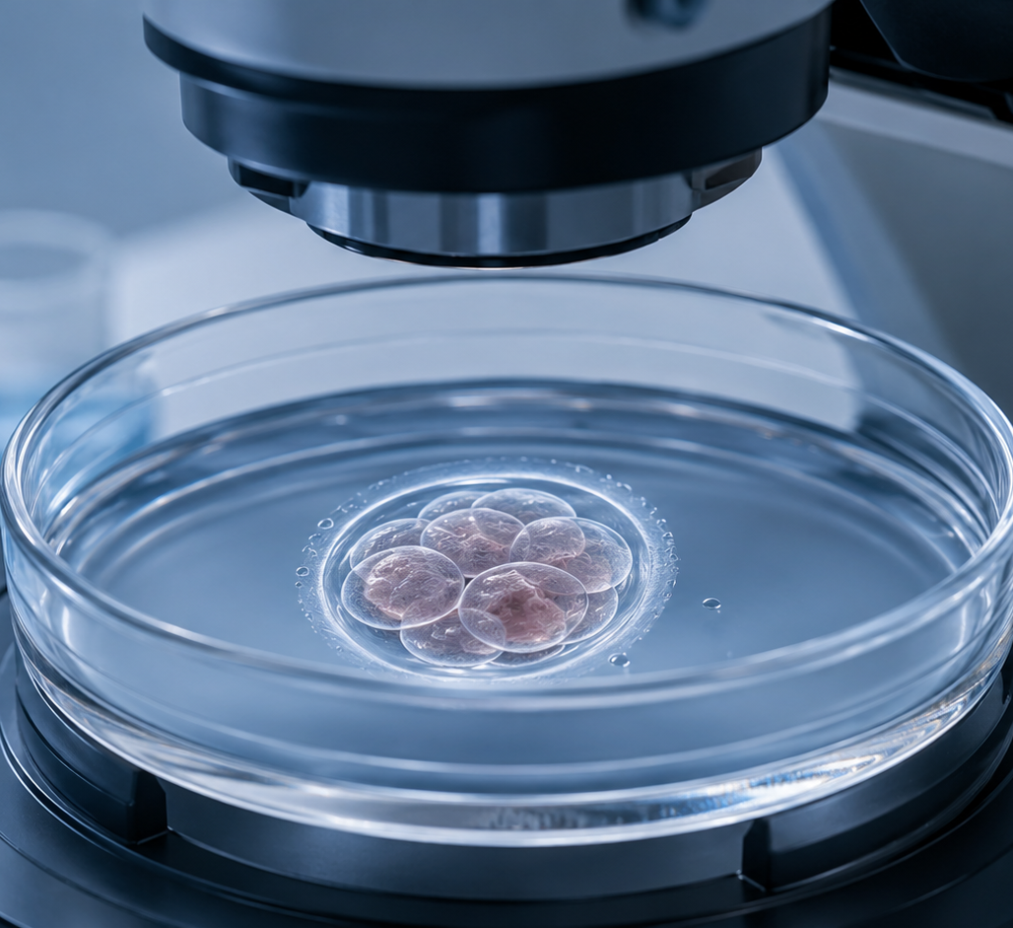
Biological and laboratory foundation
Inside Embryo by Aurion
5
The biological foundation
Embryos need a stable, low-stress in-vitro environment.
Why the environment matters
During in-vitro fertilisation, cells are handled outside the reproductive tract and may be sensitive to temperature, pH, osmolality and exposure time.
Stable temperature
Stable culture
Warm stages and short handling reduce avoidable temperature drift.
Incubators support gas, humidity and pH conditions for culture media.
Clean air
Safe workflow
Air handling helps reduce particles and chemical contamination.
Minimises avoidable handling, mixing and interruptions.
Takeaway: laboratory design protects the embryo culture micro-environment.
Inside Embryo by Aurion • Beginner • IVF Laboratory Science and Procedures
[1–4]
Notes:
Speaker notes:
A beginner should understand the laboratory as an artificial environment for gametes and embryos. The goal is not to make the room look impressive; the goal is to keep the culture micro-environment stable. Even when the room is well designed, every opening of a dish or incubator can introduce change, so design and disciplined practice work together.
Slide-production table row:
Slide number: 5 | Slide title: Basic biological or clinical foundation | Learning purpose: Introduce the biological reason for controlled design. | Exact on-slide text: Embryos need a stable, low-stress in-vitro environment. Temperature, pH, osmolality, exposure time, air quality and workflow can affect culture conditions. Takeaway: laboratory design protects the embryo culture micro-environment. | Layout description: Left macro embryo image with right explanatory cards. | Required visual: Realistic embryo-in-dish image with four environment factor cards. | Exact AI-image prompt: Create a scientifically accurate, high-resolution medical illustration of an early human embryo in a petri dish on a microscope stage. Use realistic cellular detail, soft clinical lighting, clean blue-grey scientific background and negative space. No text, labels, watermarks or fantasy elements. 16:9. | Speaker notes: A beginner should understand the laboratory as an artificial environment for gametes and embryos. The goal is not to make the room look impressive; the goal is to keep the culture micro-environment stable. Even when the room is well designed, every opening of a dish or incubator can introduce change, so design and disciplined practice work together. | Slide citation: [1–4]

Slide 6
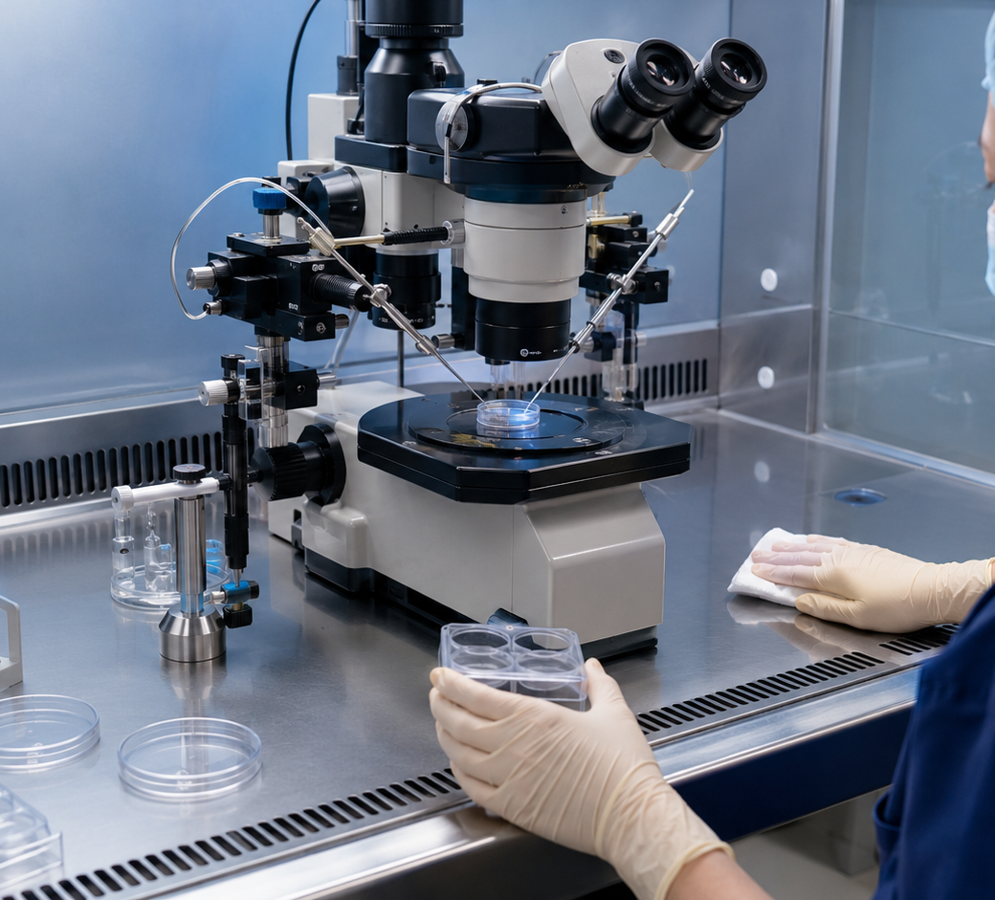
Step 1 — Start with workflow
Inside Embryo by Aurion
6
Design starts with workflow
Plan the path before planning the walls.
Patients
Clinical samples enter with identity checks.
Samples
Gametes move through defined workstations.
Embryos
Culture, observation and decisions need minimal disturbance.
Records
Every action links to traceable documentation.
Takeaway: a laboratory should make the correct pathway the easiest pathway.
Inside Embryo by Aurion • Beginner • IVF Laboratory Science and Procedures
[1,2,5]
Notes:
Speaker notes:
Workflow is the first practical design step. Before choosing finishes or equipment locations, the team maps how people, samples, consumables and records move. This prevents awkward layouts where staff repeatedly cross paths or carry embryos over unnecessary distances. Workflow should also support witnessing and traceability, because accurate identity control is a core safety requirement in ART laboratories.
Slide-production table row:
Slide number: 6 | Slide title: Step 1 — Start with workflow | Learning purpose: Show that lab design follows process flow and traceability. | Exact on-slide text: Design starts with workflow. Plan the path before planning the walls. Patients, samples, embryos and records should move through defined, traceable pathways. Takeaway: a laboratory should make the correct pathway the easiest pathway. | Layout description: Left chronological workflow cards; right realistic workstation image. | Required visual: Laboratory workstation image plus editable workflow cards. | Exact AI-image prompt: Create a scientifically accurate, high-resolution medical illustration of an IVF laboratory workstation with microscope, pipettes, dishes and controlled work surface. Use realistic laboratory detail, soft clinical lighting and clean blue-grey background. No text, labels, watermarks or fantasy elements. 16:9. | Speaker notes: Workflow is the first practical design step. Before choosing finishes or equipment locations, the team maps how people, samples, consumables and records move. This prevents awkward layouts where staff repeatedly cross paths or carry embryos over unnecessary distances. Workflow should also support witnessing and traceability, because accurate identity control is a core safety requirement in ART laboratories. | Slide citation: [1,2,5]

Slide 7
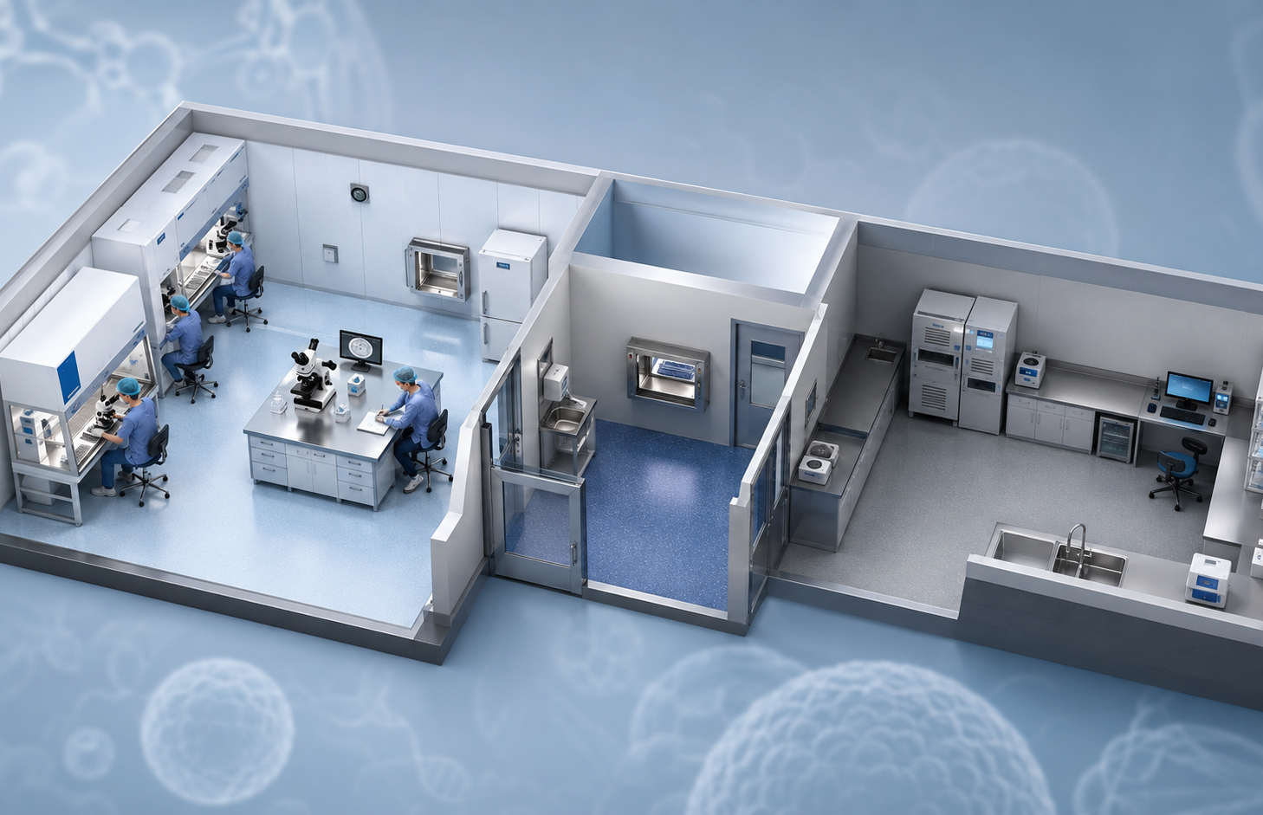
Step 2 — Zone the laboratory
Inside Embryo by Aurion
7
Zone the laboratory
Separate clean work, transition and support functions.
Core idea
Not every laboratory task needs the same environmental control.
Cleaner-to-less-clean logic
Samples and sterile consumables should not repeatedly cross dirty or crowded pathways.
Design outcome
Zones reduce unnecessary movement and protect critical manipulation areas.
Clean embryo area
Airlock / transfer
Support / utility
Takeaway: zoning creates behavioural discipline before a procedure even starts.
Inside Embryo by Aurion • Beginner • IVF Laboratory Science and Procedures
[1–3]
Notes:
Speaker notes:
Zoning helps beginners visualise the laboratory as connected functional areas. The cleanest areas support oocyte, sperm and embryo manipulation. Transition spaces reduce direct traffic into critical rooms. Support rooms can hold washing, storage, packaging or administrative tasks. Good zoning does not replace aseptic technique, but it makes contamination control easier to practise consistently.
Slide-production table row:
Slide number: 7 | Slide title: Step 2 — Zone the laboratory | Learning purpose: Teach functional zoning and clean-to-support separation. | Exact on-slide text: Zone the laboratory. Separate clean work, transition and support functions. Not every task needs the same environmental control. Cleaner-to-less-clean logic reduces unnecessary movement. Takeaway: zoning creates behavioural discipline before a procedure even starts. | Layout description: Left isometric laboratory cutaway with editable zone labels; right concept cards. | Required visual: Isometric cutaway of a zoned IVF laboratory. | Exact AI-image prompt: Create a scientifically accurate, high-resolution isometric cutaway of an IVF laboratory with a clean embryo room, airlock or transfer zone and support laboratory. Use realistic laboratory detail, soft clinical lighting and clean blue-grey background. No text, labels, watermarks or fantasy elements. 16:9. | Speaker notes: Zoning helps beginners visualise the laboratory as connected functional areas. The cleanest areas support oocyte, sperm and embryo manipulation. Transition spaces reduce direct traffic into critical rooms. Support rooms can hold washing, storage, packaging or administrative tasks. Good zoning does not replace aseptic technique, but it makes contamination control easier to practise consistently. | Slide citation: [1–3]

Slide 8
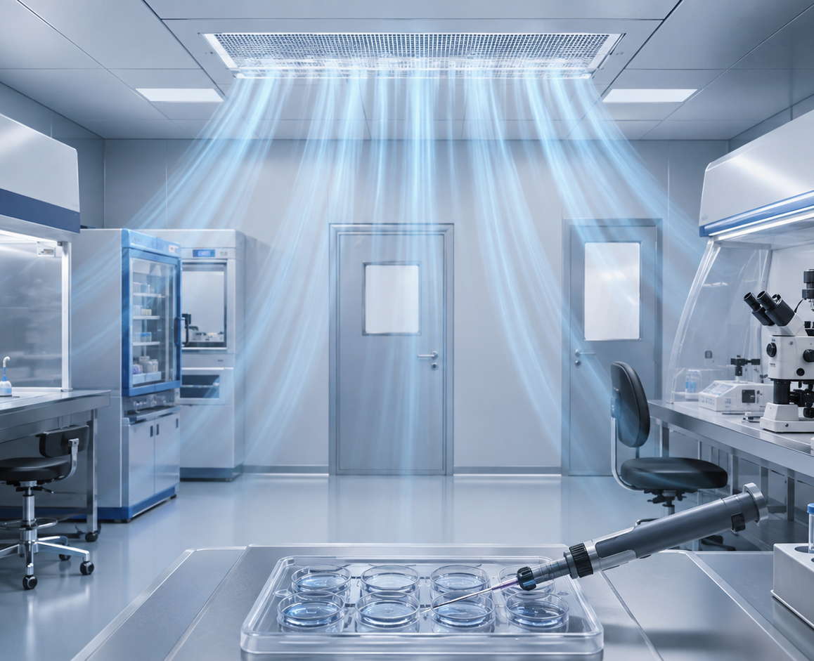
Step 3 — Control air quality
Inside Embryo by Aurion
8
Control air quality
IVF laboratories control particles, microbes and chemical exposure.
Particles
VOCs
Reduced with high-efficiency particulate air filtration.
Managed with material choice, ventilation and carbon-based chemical filtration.
Pressure
Monitoring
Positive pressure may help limit entry of outside air.
Conditions should be checked and documented over time.
Takeaway: clean air means particle control and chemical control—not only visible cleanliness.
Inside Embryo by Aurion • Beginner • IVF Laboratory Science and Procedures
[1,3,4]
Notes:
Speaker notes:
Air quality is one of the most distinctive features of IVF laboratory design. Beginners often think sterile surfaces are enough. In embryology, airborne particles, microorganisms and volatile chemicals also matter because gametes and embryos are exposed during handling. Current guidance emphasises filtered, monitored environments and careful operational practice, while recognising that evidence and regulations vary by jurisdiction.
Slide-production table row:
Slide number: 8 | Slide title: Step 3 — Control air quality | Learning purpose: Explain HEPA, VOC control and pressure in beginner language. | Exact on-slide text: Control air quality. IVF laboratories control particles, microbes and chemical exposure. Particles, VOCs, pressure and monitoring all matter. Takeaway: clean air means particle control and chemical control—not only visible cleanliness. | Layout description: Left cleanroom airflow image; right four factor cards; bottom takeaway. | Required visual: Laboratory air filtration visual with airflow over workstations. | Exact AI-image prompt: Create a scientifically accurate, high-resolution medical illustration of IVF laboratory ceiling airflow and filtration over clean workstations. Use realistic laboratory detail, soft clinical lighting and clean blue-grey scientific background. No text, labels, watermarks or fantasy elements. 16:9. | Speaker notes: Air quality is one of the most distinctive features of IVF laboratory design. Beginners often think sterile surfaces are enough. In embryology, airborne particles, microorganisms and volatile chemicals also matter because gametes and embryos are exposed during handling. Current guidance emphasises filtered, monitored environments and careful operational practice, while recognising that evidence and regulations vary by jurisdiction. | Slide citation: [1,3,4]

Slide 9
Step 4 — Choose safe materials
Inside Embryo by Aurion
9
Choose safe materials and surfaces
The room itself can become a source of risk.
Design choice
Beginner-safe principle
Why it matters
Flooring
Seamless, easy to clean, no carpet
Reduces dust and contamination traps
Walls and benches
Smooth, non-shedding, cleanable
Supports routine cleaning
Paints / sealants
Low odour and low VOC when possible
Limits chemical off-gassing
Furniture
Minimal, cleanable and needed only
Reduces clutter and particles
Rule of thumb
If a material smells strongly, sheds particles, is hard to clean or traps dust, it deserves extra scrutiny before use in embryo areas.
Takeaway: finishes and furniture are part of the embryo-culture environment.
Inside Embryo by Aurion • Beginner • IVF Laboratory Science and Procedures
[1–4]
Notes:
Speaker notes:
Materials are not decorative details in an IVF laboratory. Surfaces influence cleaning, dust load, chemical odour and staff behaviour. Many construction materials and furnishings can release volatile compounds, especially when new. For beginners, the safe principle is simple: embryo areas should use cleanable, low-shedding, low-odour materials and avoid unnecessary clutter.
Slide-production table row:
Slide number: 9 | Slide title: Step 4 — Choose safe materials | Learning purpose: Teach material and surface choices that support low contamination risk. | Exact on-slide text: Choose safe materials and surfaces. The room itself can become a source of risk. Flooring, walls, sealants and furniture should be cleanable and selected to reduce particles and chemical exposure. Takeaway: finishes and furniture are part of the embryo-culture environment. | Layout description: Simple three-column comparison table plus practical rule card. | Required visual: Editable table of material decisions. | Exact AI-image prompt: No AI image required; editable PowerPoint table and rule card. | Speaker notes: Materials are not decorative details in an IVF laboratory. Surfaces influence cleaning, dust load, chemical odour and staff behaviour. Many construction materials and furnishings can release volatile compounds, especially when new. For beginners, the safe principle is simple: embryo areas should use cleanable, low-shedding, low-odour materials and avoid unnecessary clutter. | Slide citation: [1–4]

Slide 10
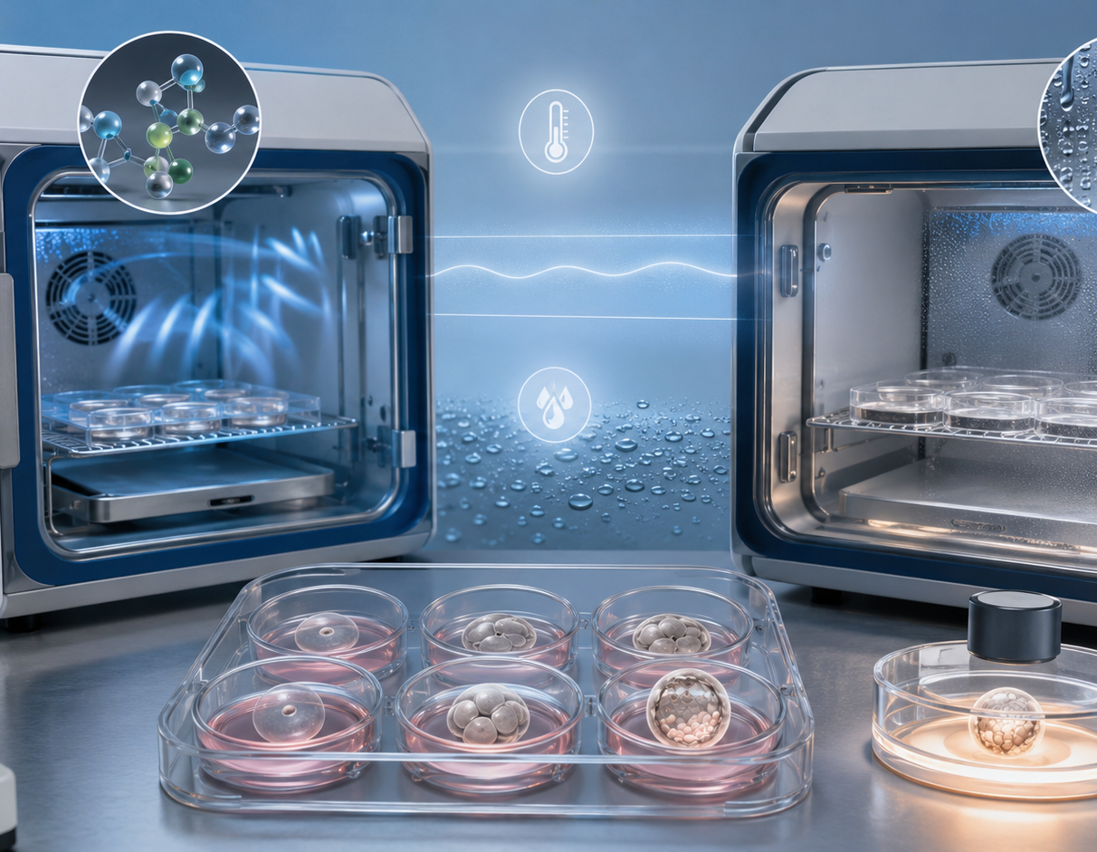
Step 5 — Place equipment around micro-environments
Inside Embryo by Aurion
10
Equipment placement protects micro-environments
Incubators, microscopes and benches must support fast, stable handling.
Incubator access
Short, planned door openings help preserve culture conditions.
Microscope proximity
Locate observation and manipulation tools to reduce transfer distance.
Alarm visibility
Critical equipment should be monitored and easy to respond to.
Backup planning
Power, gas and emergency plans are design decisions, not afterthoughts.
Takeaway: the best equipment layout reduces disturbance and prevents rushed handling.
Inside Embryo by Aurion • Beginner • IVF Laboratory Science and Procedures
[1,2,6]
Notes:
Speaker notes:
Equipment placement links the room design to daily embryology practice. Incubators create a controlled micro-environment, but culture dishes still experience change when they are moved or exposed. Microscope stations, warming surfaces and nearby consumables should reduce handling time. Design should also make alarms, gas supply, power backup and emergency responses visible and practical.
Slide-production table row:
Slide number: 10 | Slide title: Step 5 — Place equipment around micro-environments | Learning purpose: Connect equipment placement to culture stability and operational safety. | Exact on-slide text: Equipment placement protects micro-environments. Incubators, microscopes, alarm visibility and backup planning should support fast, stable handling. Takeaway: the best equipment layout reduces disturbance and prevents rushed handling. | Layout description: Left incubator/culture image; right stacked equipment-principle cards. | Required visual: Realistic incubator and embryo culture image. | Exact AI-image prompt: Create a scientifically accurate, high-resolution medical illustration of IVF incubators, culture dishes and microscope in a controlled embryology laboratory. Use realistic laboratory detail, soft clinical lighting, clean blue-grey background and negative space. No text, labels, watermarks or fantasy elements. 16:9. | Speaker notes: Equipment placement links the room design to daily embryology practice. Incubators create a controlled micro-environment, but culture dishes still experience change when they are moved or exposed. Microscope stations, warming surfaces and nearby consumables should reduce handling time. Design should also make alarms, gas supply, power backup and emergency responses visible and practical. | Slide citation: [1,2,6]

Slide 11
Simple process flowchart
Inside Embryo by Aurion
11
IVF laboratory design process
A beginner-friendly sequence from plan to safe operation.
Input
Design process
Outcome
Clinical need
Workflow map
Zoning plan
Air & material control
Equipment layout
QC + SOPs
Operational review
Controlled laboratory practice
Takeaway: good IVF design is planned, validated, documented and reviewed.
Inside Embryo by Aurion • Beginner • IVF Laboratory Science and Procedures
[1,2,5]
Notes:
Speaker notes:
This slide provides the complete beginner sequence. A real laboratory design project may involve architects, engineers, regulators and senior embryologists, but the conceptual order is simple. First define the clinical need and workflow. Then design zones, environmental controls and equipment positions. Finally, operate through validated procedures, monitoring, documentation and periodic review.
Slide-production table row:
Slide number: 11 | Slide title: Simple process flowchart | Learning purpose: Show the full design process in a single editable flowchart. | Exact on-slide text: Clinical need → Workflow map → Zoning plan → Air & material control → Equipment layout → QC + SOPs → Operational review. Takeaway: good IVF design is planned, validated, documented and reviewed. | Layout description: Seven-node horizontal teal/gold flowchart with bottom outcome chevron. | Required visual: Complete editable process flowchart. | Exact AI-image prompt: No AI image required; editable PowerPoint vector flowchart with teal cards and muted gold arrows. | Speaker notes: This slide provides the complete beginner sequence. A real laboratory design project may involve architects, engineers, regulators and senior embryologists, but the conceptual order is simple. First define the clinical need and workflow. Then design zones, environmental controls and equipment positions. Finally, operate through validated procedures, monitoring, documentation and periodic review. | Slide citation: [1,2,5]

Slide 12
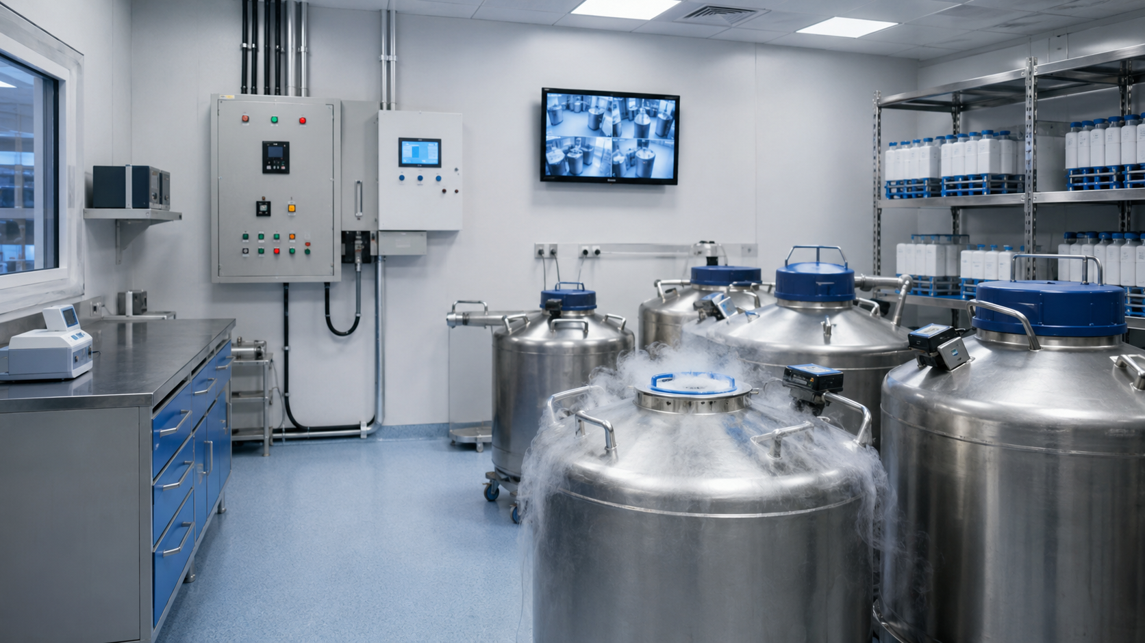
Important structures and classifications
Inside Embryo by Aurion
12
Core zones in an IVF laboratory
Each zone has a specific protective purpose.
Critical manipulation zone
Culture zone
Oocyte search, insemination, ICSI, embryo handling
Incubators and controlled embryo culture
Transition zone
Support zone
Gowning, pass-through, reduced traffic entry
Preparation, storage, washing or utility tasks
Cryostorage zone
Liquid nitrogen storage and inventory control
Takeaway: classification helps staff know what control level each activity needs.
Inside Embryo by Aurion • Beginner • IVF Laboratory Science and Procedures
[1,2,6]
Notes:
Speaker notes:
A beginner should learn zones by purpose rather than memorising room names. Critical manipulation and culture zones protect gametes and embryos during the most sensitive steps. Transition and support zones reduce traffic and keep non-critical tasks away from embryo handling. Cryostorage needs its own safety planning because it involves biological inventory and liquid nitrogen hazards.
Slide-production table row:
Slide number: 12 | Slide title: Important structures, stages or classifications | Learning purpose: Classify the main IVF laboratory zones and their purposes. | Exact on-slide text: Core zones in an IVF laboratory. Critical manipulation zone; Culture zone; Transition zone; Support zone; Cryostorage zone. Takeaway: classification helps staff know what control level each activity needs. | Layout description: Five labelled zone cards and a cryostorage visual label. | Required visual: Zone classification cards plus cryostorage image. | Exact AI-image prompt: Create a scientifically accurate, high-resolution medical illustration of IVF cryostorage dewars and controlled storage room with monitoring equipment. Use realistic laboratory detail, soft clinical lighting and clean blue-grey background. No text, labels, watermarks or fantasy elements. 16:9. | Speaker notes: A beginner should learn zones by purpose rather than memorising room names. Critical manipulation and culture zones protect gametes and embryos during the most sensitive steps. Transition and support zones reduce traffic and keep non-critical tasks away from embryo handling. Cryostorage needs its own safety planning because it involves biological inventory and liquid nitrogen hazards. | Slide citation: [1,2,6]

Slide 13
Basic comparison
Inside Embryo by Aurion
13
Andrology space vs embryo culture laboratory
Both are important, but their environmental needs are not identical.
ANDROLOGY SPACE
EMBRYO CULTURE LAB
• What happens: semen analysis and sperm preparation.
• What happens: oocyte, zygote and embryo handling/culture.
• Main difference: lower environmental sensitivity than open embryo handling.
• Main difference: stricter control of air, heat and disturbance.
• Important limitation: sterile sperm preparation still needs separation and QC.
• Important limitation: design supports outcomes but cannot guarantee them.
Takeaway: similar labels do not mean identical design requirements.
Inside Embryo by Aurion • Beginner • IVF Laboratory Science and Procedures
[1,2]
Notes:
Speaker notes:
Beginners sometimes assume all ART laboratory areas are designed the same way. Andrology and embryo culture both require quality systems and careful identification, but the embryo culture laboratory usually demands higher control of air quality, temperature stability and disturbance. This comparison also reinforces an important limitation: a better design supports safer practice; it does not guarantee a pregnancy or live birth.
Slide-production table row:
Slide number: 13 | Slide title: Basic comparison | Learning purpose: Compare two commonly confused laboratory areas. | Exact on-slide text: Andrology space vs embryo culture laboratory. Andrology: semen analysis and sperm preparation; lower environmental sensitivity than open embryo handling; sterile preparation still needs separation and QC. Embryo culture lab: oocyte, zygote and embryo handling/culture; stricter control of air, heat and disturbance; design supports outcomes but cannot guarantee them. | Layout description: Symmetrical split-screen comparison with matching categories. | Required visual: Editable split-screen comparison panels. | Exact AI-image prompt: No AI image required; editable PowerPoint split-screen comparison panel. | Speaker notes: Beginners sometimes assume all ART laboratory areas are designed the same way. Andrology and embryo culture both require quality systems and careful identification, but the embryo culture laboratory usually demands higher control of air quality, temperature stability and disturbance. This comparison also reinforces an important limitation: a better design supports safer practice; it does not guarantee a pregnancy or live birth. | Slide citation: [1,2]

Slide 14
Factors influencing the process or outcome
Inside Embryo by Aurion
14
IVF laboratory performance is multifactorial
Design interacts with people, biology and quality systems.
Air quality
Staff practice
Equipment
HEPA + VOC control
Training + discipline
Monitoring + backup
IVF lab
performance
Gamete biology
Workflow
Patient-specific variation
Consumables
Traceability + minimal disturbance
Toxicity and lot control
Takeaway: ART outcomes are multifactorial; no single design feature predicts success.
Inside Embryo by Aurion • Beginner • IVF Laboratory Science and Procedures
[1–5]
Notes:
Speaker notes:
This slide prevents a common overstatement: laboratory design matters, but it is not the only determinant of ART outcomes. Embryo development reflects gamete biology, patient factors, stimulation, laboratory skill, culture conditions, consumables, equipment and transfer decisions. Design helps control the laboratory part of the system. It should be integrated with training and quality management.
Slide-production table row:
Slide number: 14 | Slide title: Factors that influence the process or outcome | Learning purpose: Show that design is one part of a multifactorial ART system. | Exact on-slide text: IVF laboratory performance is multifactorial. Air quality; staff practice; equipment; gamete biology; consumables; workflow. Takeaway: ART outcomes are multifactorial; no single design feature predicts success. | Layout description: Central dark navy circle connected to six surrounding teal-outlined factor cards with gold arrows. | Required visual: Editable central-hub multifactorial diagram. | Exact AI-image prompt: No AI image required; editable central-hub diagram with navy centre, teal factor cards and muted gold connectors. | Speaker notes: This slide prevents a common overstatement: laboratory design matters, but it is not the only determinant of ART outcomes. Embryo development reflects gamete biology, patient factors, stimulation, laboratory skill, culture conditions, consumables, equipment and transfer decisions. Design helps control the laboratory part of the system. It should be integrated with training and quality management. | Slide citation: [1–5]

Slide 15
Common misconceptions and beginner errors
Inside Embryo by Aurion
15
Common beginner misconceptions
Correcting these early prevents unsafe assumptions.
“A sterile room is enough.”
“More equipment means better lab.”
Embryology also needs stable air chemistry, temperature and workflow.
Poorly placed equipment can increase disturbance and risk.
“Design guarantees pregnancy.”
“Andrology and embryo culture are the same.”
Design supports safe practice; outcomes remain multifactorial.
They overlap, but environmental needs differ.
“Cleaning products are always harmless.”
Odours and residues may matter in embryo areas.
Takeaway: good teaching separates design support from biological certainty.
Inside Embryo by Aurion • Beginner • IVF Laboratory Science and Procedures
[1–4]
Notes:
Speaker notes:
These misconceptions are common when learners first encounter IVF laboratory design. The strongest correction is not to create fear, but to teach systems thinking. Good design lowers avoidable risk, supports consistency and protects the culture environment. It does not remove biological variation or replace skilled embryologists, validated methods, equipment maintenance or clinical judgement.
Slide-production table row:
Slide number: 15 | Slide title: Common misconceptions or beginner errors | Learning purpose: Correct common beginner errors with calm evidence-based language. | Exact on-slide text: Misconceptions: A sterile room is enough; More equipment means better lab; Design guarantees pregnancy; Andrology and embryo culture are the same; Cleaning products are always harmless. Takeaway: good teaching separates design support from biological certainty. | Layout description: Five misconception-correction cards in a balanced grid. | Required visual: Editable misconception cards. | Exact AI-image prompt: No AI image required; editable misconception and correction cards. | Speaker notes: These misconceptions are common when learners first encounter IVF laboratory design. The strongest correction is not to create fear, but to teach systems thinking. Good design lowers avoidable risk, supports consistency and protects the culture environment. It does not remove biological variation or replace skilled embryologists, validated methods, equipment maintenance or clinical judgement. | Slide citation: [1–4]

Slide 16

Practical and clinical relevance
Inside Embryo by Aurion
16
Where learners see design in practice
Design becomes visible during everyday IVF laboratory work.
During oocyte pick-up
Quick transfer to controlled handling areas.
During insemination / ICSI
Microscope, warming and media stations nearby.
During culture checks
Incubator access and observation workflow matter.
During cryostorage
Inventory, alarms and safety planning protect specimens.
Takeaway: design appears in every handoff, observation, record and emergency response.
Inside Embryo by Aurion • Beginner • IVF Laboratory Science and Procedures
[1,2,6]
Notes:
Speaker notes:
In daily practice, learners encounter design through the movement of dishes, labels, instruments, records and people. The layout either supports or complicates each handoff. This slide is educational only; real clinics must follow their own validated standard operating procedures, local regulations and institutional safety systems. The principle is that design should make safe practice visible and easy.
Slide-production table row:
Slide number: 16 | Slide title: Practical or clinical relevance | Learning purpose: Connect the design concept to clinic and laboratory tasks without medical advice. | Exact on-slide text: Where learners see design in practice: oocyte pick-up, insemination / ICSI, culture checks and cryostorage. Takeaway: design appears in every handoff, observation, record and emergency response. | Layout description: Left sample-traceability image; right practical event cards. | Required visual: Sample tracking and double-checking laboratory scene. | Exact AI-image prompt: Create a scientifically accurate, high-resolution medical illustration of IVF laboratory staff handling labelled dishes and records for traceability. Use realistic laboratory detail, soft clinical lighting and clean blue-grey background. No text, labels, watermarks or fantasy elements. 16:9. | Speaker notes: In daily practice, learners encounter design through the movement of dishes, labels, instruments, records and people. The layout either supports or complicates each handoff. This slide is educational only; real clinics must follow their own validated standard operating procedures, local regulations and institutional safety systems. The principle is that design should make safe practice visible and easy. | Slide citation: [1,2,6]

Slide 17
Key takeaways
Inside Embryo by Aurion
17
Key takeaways
A visual recap of the foundation concepts.
1
IVF laboratory design is a biological safety concept.
2
Workflow comes before room aesthetics.
Equipment
Workflow
3
Zoning separates clean, transition and support tasks.
CONTROLLED
PRACTICE
4
Air quality includes particles and chemical contaminants.
Air
Zones
5
Materials and cleaning choices matter.
6
Equipment layout protects micro-environments.
7
Outcomes are multifactorial and never guaranteed.
Takeaway: a premium IVF lab is designed for embryos, staff and safe decisions.
Inside Embryo by Aurion • Beginner • IVF Laboratory Science and Procedures
[1–6]
Notes:
Speaker notes:
This recap should help learners build a mental framework. IVF laboratory design is not separate from embryology; it shapes how embryos, people and data move through the system. The most important beginner message is balance: control what the laboratory can control, document it, review it, and never present laboratory design as a guarantee of treatment success.
Slide-production table row:
Slide number: 17 | Slide title: Key takeaways | Learning purpose: Summarise the essential points learners should remember. | Exact on-slide text: IVF laboratory design is a biological safety concept. | Workflow comes before room aesthetics. | Zoning separates clean, transition and support tasks. | Air quality includes particles and chemical contaminants. | Materials and cleaning choices matter. | Equipment layout protects micro-environments. | Outcomes are multifactorial and never guaranteed. | Takeaway: a premium IVF lab is designed for embryos, staff and safe decisions. | Layout description: Left numbered recap list; right compact central infographic. | Required visual: Editable summary infographic and numbered list. | Exact AI-image prompt: No AI image required; editable recap infographic. | Speaker notes: This recap should help learners build a mental framework. IVF laboratory design is not separate from embryology; it shapes how embryos, people and data move through the system. The most important beginner message is balance: control what the laboratory can control, document it, review it, and never present laboratory design as a guarantee of treatment success. | Slide citation: [1–6]

Slide 18
Knowledge check
Inside Embryo by Aurion
18
Knowledge check
Five quick beginner-level questions.
Question 1
True/False: IVF lab design can guarantee live birth.
Question 2
Which term refers to airborne chemicals: HEPA or VOC?
Question 3
Name one reason for zoning an IVF laboratory.
Question 4
Multiple choice: What should come first? A) workflow map B) paint colour C) furniture style
Question 5
Identify one feature that protects culture stability.
Answers are provided in speaker notes.
Inside Embryo by Aurion • Beginner • IVF Laboratory Science and Procedures
None
Notes:
Speaker notes:
Answers: 1. False. Laboratory design supports safer, more consistent practice but cannot guarantee live birth. 2. VOC means volatile organic compound; HEPA refers to particulate air filtration. 3. Zoning reduces unnecessary traffic, separates clean and support tasks, and supports contamination control. 4. A, workflow map. 5. Examples include incubator stability, warm stages, controlled air quality and short planned handling.
Slide-production table row:
Slide number: 18 | Slide title: Knowledge check | Learning purpose: Assess learner recall using five beginner-level questions. | Exact on-slide text: 1. True/False: IVF lab design can guarantee live birth. | 2. Which term refers to airborne chemicals: HEPA or VOC? | 3. Name one reason for zoning an IVF laboratory. | 4. Multiple choice: What should come first? A) workflow map B) paint colour C) furniture style | 5. Identify one feature that protects culture stability. Answers are provided in speaker notes. | Layout description: Five stacked editable question cards. | Required visual: Editable question cards. | Exact AI-image prompt: No AI image required; editable question cards. | Speaker notes: Answers: 1. False. Laboratory design supports safer, more consistent practice but cannot guarantee live birth. 2. VOC means volatile organic compound; HEPA refers to particulate air filtration. 3. Zoning reduces unnecessary traffic, separates clean and support tasks, and supports contamination control. 4. A, workflow map. 5. Examples include incubator stability, warm stages, controlled air quality and short planned handling. | Slide citation: None

Slide 19
References
Inside Embryo by Aurion
19
References
Selected authoritative sources in Vancouver style.
1. ESHRE Guideline Group on Good Practice in IVF Labs. ESHRE recommendations on Good Practice in the IVF laboratory. Hum Reprod. 2026. doi:10.1093/humrep/deag096.
2. Practice Committee of the American Society for Reproductive Medicine. Comprehensive guidance for human embryology, andrology, and endocrinology laboratories: management and operations: a committee opinion. Fertil Steril. 2022.
3. Mortimer D, Cohen J, Mortimer ST, Fawzy M, McCulloh DH, Morbeck DE, et al. Cairo consensus on the IVF laboratory environment and air quality: report of an expert meeting. Reprod Biomed Online. 2018;36(6):658–674.
4. Sciorio R, Rapalini E, Esteves SC. Air quality in the clinical embryology laboratory: a mini-review. Ther Adv Reprod Health. 2021;15:2633494121990684.
5. ESHRE Special Interest Group of Embryology; Alpha Scientists in Reproductive Medicine. The Vienna consensus: report of an expert meeting on the development of ART laboratory performance indicators. Hum Reprod Open. 2017;2017(2):hox011.
6. Practice Committees of ASRM, SART and SRBT. Cryostorage of reproductive tissues in the in vitro fertilization laboratory: a committee opinion. Fertil Steril. 2020;114(3):486–491.
7. Mortimer ST, Mortimer D. Quality and Risk Management in the IVF Laboratory. 2nd ed. Cambridge: Cambridge University Press; 2015.
8. Montag M, Morbeck D. Principles of IVF Laboratory Practice: Optimizing Performance and Outcomes. Cambridge: Cambridge University Press; 2017.
Inside Embryo by Aurion • Beginner • IVF Laboratory Science and Procedures
References [1–8]
Notes:
Speaker notes:
These references were selected to prioritise professional guidelines, consensus documents, peer-reviewed reviews and specialist textbooks. Beginners do not need to read every source immediately, but they should recognise the difference between authoritative guidance and informal online advice. Local laws, accreditation rules and institutional protocols must always be checked separately.
Slide-production table row:
Slide number: 19 | Slide title: References | Learning purpose: Provide authoritative sources supporting the presentation. | Exact on-slide text: 1. ESHRE Guideline Group on Good Practice in IVF Labs. ESHRE recommendations on Good Practice in the IVF laboratory. Hum Reprod. 2026. doi:10.1093/humrep/deag096. | 2. Practice Committee of the American Society for Reproductive Medicine. Comprehensive guidance for human embryology, andrology, and endocrinology laboratories: management and operations: a committee opinion. Fertil Steril. 2022. | 3. Mortimer D, Cohen J, Mortimer ST, Fawzy M, McCulloh DH, Morbeck DE, et al. Cairo consensus on the IVF laboratory environment and air quality: report of an expert meeting. Reprod Biomed Online. 2018;36(6):658–674. | 4. Sciorio R, Rapalini E, Esteves SC. Air quality in the clinical embryology laboratory: a mini-review. Ther Adv Reprod Health. 2021;15:2633494121990684. | 5. ESHRE Special Interest Group of Embryology; Alpha Scientists in Reproductive Medicine. The Vienna consensus: report of an expert meeting on the development of ART laboratory performance indicators. Hum Reprod Open. 2017;2017(2):hox011. | 6. Practice Committees of ASRM, SART and SRBT. Cryostorage of reproductive tissues in the in vitro fertilization laboratory: a committee opinion. Fertil Steril. 2020;114(3):486–491. | 7. Mortimer ST, Mortimer D. Quality and Risk Management in the IVF Laboratory. 2nd ed. Cambridge: Cambridge University Press; 2015. | 8. Montag M, Morbeck D. Principles of IVF Laboratory Practice: Optimizing Performance and Outcomes. Cambridge: Cambridge University Press; 2017. | Layout description: Vancouver-style reference list on ivory background. | Required visual: Editable reference list. | Exact AI-image prompt: No AI image required; editable Vancouver references. | Speaker notes: These references were selected to prioritise professional guidelines, consensus documents, peer-reviewed reviews and specialist textbooks. Beginners do not need to read every source immediately, but they should recognise the difference between authoritative guidance and informal online advice. Local laws, accreditation rules and institutional protocols must always be checked separately. | Slide citation: References [1–8]

Slide 20
Thank You
Inside Embryo by Aurion
This presentation is intended for scientific and educational use. It does not replace institutional protocols, formal professional training, clinical judgement or individual medical advice. ART outcomes are multifactorial and cannot be predicted from a single test, observation, embryo grade or laboratory parameter.
insideembryo.com
Beginner foundation deck • IVF Laboratory Science and Procedures
None
Notes:
Speaker notes:
Use this final slide to reinforce responsible educational boundaries. The presentation explains design principles, but it is not a protocol, accreditation checklist or medical recommendation. Learners should always follow validated institutional procedures and local regulatory requirements. The final message is simple: design supports good embryology practice, but ART outcomes remain multifactorial.
Slide-production table row:
Slide number: 20 | Slide title: Educational disclaimer and closing slide | Learning purpose: Close the presentation and define educational-use limitations. | Exact on-slide text: Thank You. Inside Embryo by Aurion. This presentation is intended for scientific and educational use. It does not replace institutional protocols, formal professional training, clinical judgement or individual medical advice. ART outcomes are multifactorial and cannot be predicted from a single test, observation, embryo grade or laboratory parameter. insideembryo.com. Beginner foundation deck • IVF Laboratory Science and Procedures. | Layout description: Dark navy closing slide with disclaimer box over a cryostorage laboratory image. | Required visual: Cryostorage laboratory image as contextual background. | Exact AI-image prompt: Create a scientifically accurate, high-resolution medical illustration of a clean IVF cryogenic storage room with stainless steel liquid nitrogen dewars, monitoring equipment and soft clinical lighting. Use a premium educational aesthetic. No text, labels, watermarks or fantasy elements. 16:9. | Speaker notes: Use this final slide to reinforce responsible educational boundaries. The presentation explains design principles, but it is not a protocol, accreditation checklist or medical recommendation. Learners should always follow validated institutional procedures and local regulatory requirements. The final message is simple: design supports good embryology practice, but ART outcomes remain multifactorial. | Slide citation: None

