Slide 1
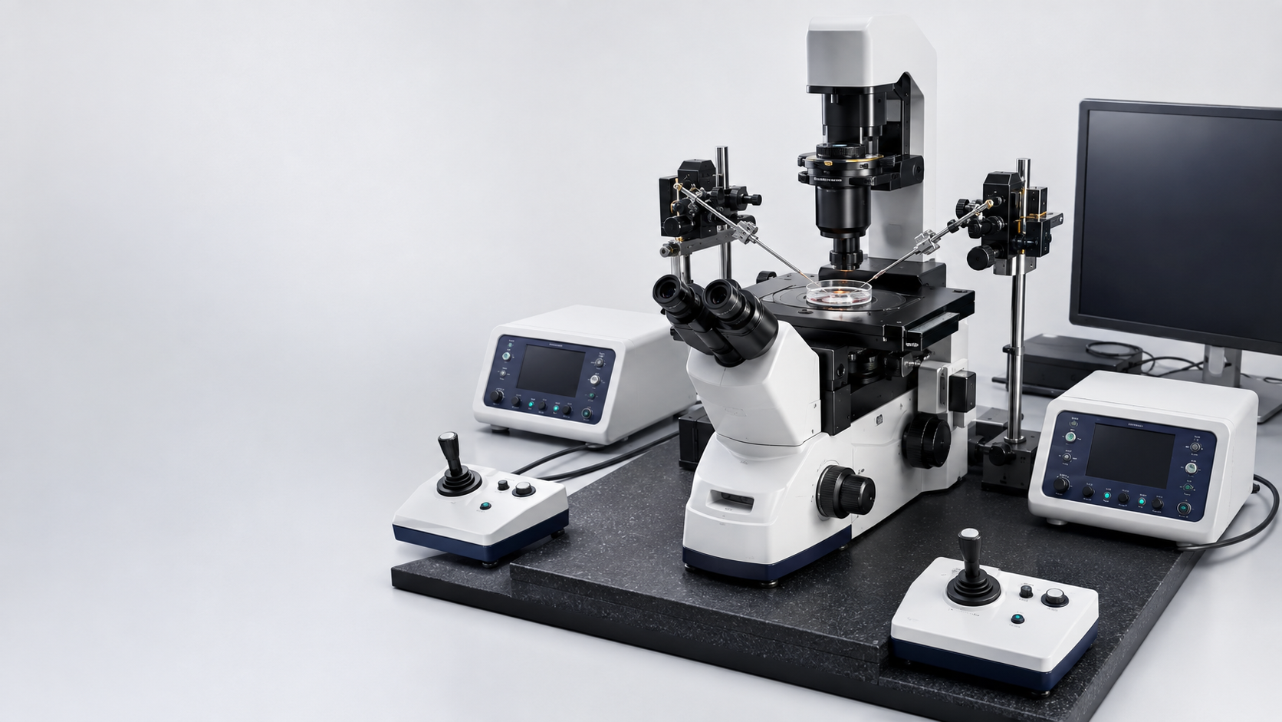
INSIDE EMBRYO
BY AURION
Micromanipulator
Setup
Building a reliable IVF workstation
A beginner training deck on readiness, control and safe escalation
BEGINNER LEVEL
Prepared by Manoj Kumar K, Embryologist
Inside Embryo by Aurion • 9 August 2026
Educational illustration; not a clinical photograph.
Notes:
Open by framing setup as a release decision, not as a collection of knobs. The deck is educational and must be paired with supervised training and the local SOP.
[Sources]
- https://doi.org/10.1093/humrep/deag096
- https://doi.org/10.1093/hropen/hoad001

Slide 2
Four decisions define a safe beginner setup
02
The goal is reasoning, not memorising device-specific values
4
1
SEE
Identify the optical path, manipulators, injectors, heated stage and pipettes.
2
CONTROL
Explain how movement, focus, pressure and environment interact.
3
RELEASE
Follow a supervised pre-use sequence and functional check.
By the end, you should be able to…
4
STOP
Recognise faults that require correction, rechecking or escalation.
This deck does not authorise unsupervised manipulation of human gametes or embryos.
INSIDE EMBRYO BY AURION • EMBRYOLOGY & IVF LABORATORY SCIENCE
MANOJ KUMAR K • 02
Notes:
Use the four verbs to establish the learning contract. Emphasise that competence requires supervised practice, observed performance and local authorisation.
[Sources]
- https://doi.org/10.1093/humrep/deag096
- https://doi.org/10.1093/hropen/hoad001

Slide 3
Setup is a readiness gate in the ART pathway
03
It prepares a platform; it does not decide the treatment indication
1
2
3
4
5
Clinical plan
Gamete prep
Station release
Procedure
Post-procedure
Indication, consent, identity
Oocyte and sperm readiness
Setup + functional checks
ICSI, hatching or biopsy
Assessment, culture, traceability
Clinical choice and technical readiness answer different questions
A workstation can be technically ready while a procedure is not clinically indicated—and a valid indication cannot compensate for an unready station.
INSIDE EMBRYO BY AURION • EMBRYOLOGY & IVF LABORATORY SCIENCE
MANOJ KUMAR K • 03
Notes:
Separate two decisions: whether a procedure should be used and whether the station is technically fit for use. This protects against treating equipment capability as clinical justification.
[Sources]
- https://doi.org/10.1093/humrep/deag029
- https://www.asrm.org/practice-guidance/practice-committee-documents/intracytoplasmic-sperm-injection-for-nonmale-factor-indications-a-committee-opinion-2026/
- https://doi.org/10.1093/humrep/deag096

Slide 4
Four interfaces define reliable setup
04
A fault in one interface can invalidate the whole release decision
VISION
PRESSURE
focus • contrast • focal plane
SETUP
CONTROL
aspiration • neutral • expulsion
MOTION
ENVIRONMENT
coarse travel • fine control • drift
Optical clarity without stable movement is not readiness.
Precise movement without predictable pressure is not readiness.
temperature • exposure • vibration
INSIDE EMBRYO BY AURION • EMBRYOLOGY & IVF LABORATORY SCIENCE
MANOJ KUMAR K • 04
Notes:
Use this as the deck's organising model. The four interfaces are a teaching abstraction; the local equipment qualification and SOP determine the exact checks.
[Sources]
- https://doi.org/10.1093/humrep/deag096

Slide 5
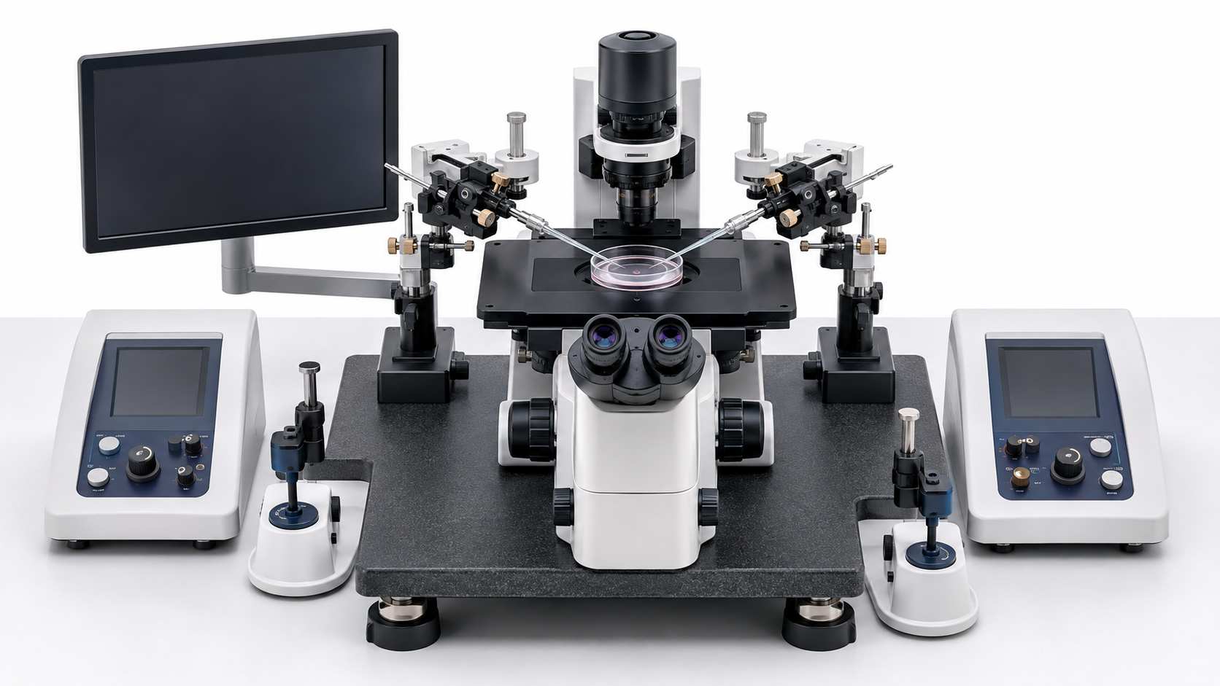
The workstation behaves as one system
05
Each component has a distinct control job
1
Inverted microscope
Makes the dish and pipette tips visible.
2
Manipulators
1
Translate hand movement into controlled three-axis travel.
3
Microinjectors
2
Create controlled negative, neutral or positive pressure.
5
4
Heated stage
4
Supports validated handling temperature at the working surface.
5
Pipette holders
Secure geometry and connect the pressure path.
3
6
Anti-vibration support
Reduces external mechanical disturbance.
6
Educational illustration; device layouts vary.
INSIDE EMBRYO BY AURION • EMBRYOLOGY & IVF LABORATORY SCIENCE
MANOJ KUMAR K • 05
Notes:
Point out that local device design varies. The conceptual control jobs remain: see, move, apply pressure, protect the environment and stabilise the platform.
[Sources]
- https://doi.org/10.1093/humrep/deag096

Slide 6
Two arms, two jobs, one focal plane
06
Holding creates stability; the working side creates the intended procedure-specific action
H
W
HOLDING SIDE
WORKING SIDE
✓
Blunt tip stabilises the cell or embryo.
✓
Fine, procedure-specific pipette performs the action.
ONE
FOCAL
PLANE
✓
Negative pressure is gentle and controlled.
✓
Geometry, bevel and diameter must match the validated task.
✓
Excess suction or poor centring can distort the target.
✓
Blocked, damaged or misaligned tips require replacement.
INSIDE EMBRYO BY AURION • EMBRYOLOGY & IVF LABORATORY SCIENCE
MANOJ KUMAR K • 06
Notes:
Do not teach a universal left/right convention; systems and local workflows vary. Teach the functional distinction between stabilising and working sides.
[Sources]
- https://doi.org/10.1093/humrep/deag029
- https://doi.org/10.1093/humrep/deag096

Slide 7
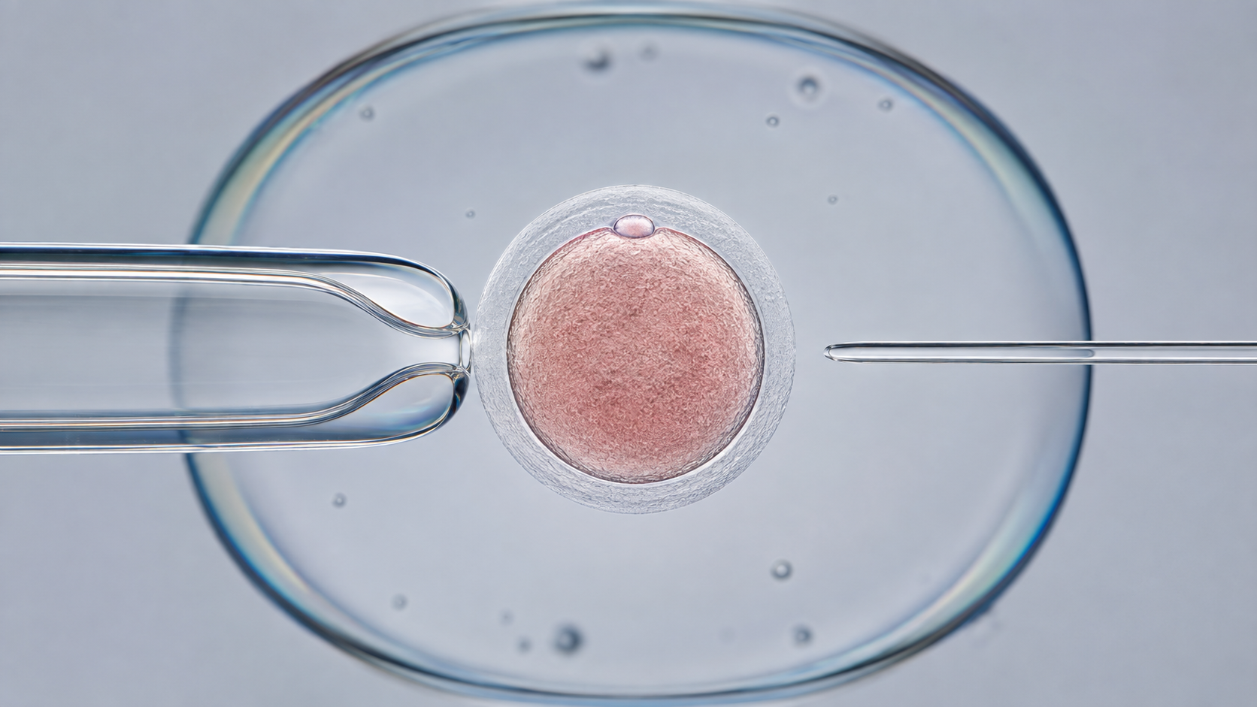
Alignment is three-dimensional
07
Both tips must be centred, sharply focused and mechanically stable
THE 3-POINT ALIGNMENT TEST
1
Same focal plane
Both tips remain sharp without refocusing.
2
Coaxial approach
Tips share a stable horizontal working axis.
3
Clear travel
Movement is smooth, centred and free of dish contact.
Any change = STOP and realign.
Educational illustration; no penetration is shown.
INSIDE EMBRYO BY AURION • EMBRYOLOGY & IVF LABORATORY SCIENCE
MANOJ KUMAR K • 07
Notes:
Alignment is checked before introducing reproductive material. Avoid teaching by appearance alone; stability through fine movement matters.
[Sources]
- https://doi.org/10.1093/humrep/deag096
- https://doi.org/10.1093/hropen/hoaa020

Slide 8
Pressure must be predictable before use
08
Test response in acellular droplets—not on reproductive material
NEGATIVE
NEUTRAL
POSITIVE
←
•
→
ASPIRATION / HOLD
NO INTENDED FLOW
EXPULSION
Controlled inward flow
No spontaneous drift
Controlled outward flow
Leaks, bubbles or blockage make pressure delayed or non-linear.
Use the manufacturer instructions, validated local SOP and supervised training—never a universal memorised setting.
INSIDE EMBRYO BY AURION • EMBRYOLOGY & IVF LABORATORY SCIENCE
MANOJ KUMAR K • 08
Notes:
Describe direction and response, not numeric settings. The acceptable response is device-, pipette- and SOP-specific and should be functionally checked before use.
[Sources]
- https://doi.org/10.1093/humrep/deag096
- https://doi.org/10.1093/hropen/hoaa020

Slide 9
Microenvironment instability blocks release
09
Setup must protect reproductive material during the handling interval
TEMPERATURE
Risk: heat loss at the dish and working surface
Control: verify the heated stage with a calibrated method
pH & EXPOSURE
Risk: prolonged handling or unsuitable buffering
Control: validated media, timing and local gas/air workflow
LIGHT
Risk: unnecessary optical exposure
Control: adequate visibility with minimal exposure
VIBRATION & CLEANLINESS
Risk: tip drift, mechanical shock or contamination
Control: stable support, clean surfaces and controlled access
Do not copy a numerical target from a teaching slide: use the validated range in the local SOP.
INSIDE EMBRYO BY AURION • EMBRYOLOGY & IVF LABORATORY SCIENCE
MANOJ KUMAR K • 09
Notes:
ESHRE recommends appropriate heated devices, calibrated measurement, accepted ranges and correction of out-of-range parameters. The local validation defines the release range.
[Sources]
- https://doi.org/10.1093/humrep/deag096

Slide 10
Eight steps create a release decision
10
The sequence is conceptual; the local SOP supplies exact checks and ranges
1
2
3
4
Review
Stabilise
Verify
Mount
SOP, procedure, readiness criteria
Clean, power and allow station stability
Heated-stage temperature
Correct pipettes and secure holders
8
7
6
5
Release
Test
Align
Prime
Document or escalate
Movement and pressure acellularly
Tips in one focal plane
Pressure path; no bubbles or leaks
INSIDE EMBRYO BY AURION • EMBRYOLOGY & IVF LABORATORY SCIENCE
MANOJ KUMAR K • 10
Notes:
Walk through the readiness path. If any critical check fails, the pathway stops until the fault is corrected, rechecked and documented or escalated.
[Sources]
- https://doi.org/10.1093/humrep/deag096
- https://doi.org/10.1093/hropen/hoaa020

Slide 11
Functional checks authorise release
11
Perform the checks without reproductive material in the dish
TEST IN ACELLULAR DROPLETS
RELEASE?
✓
Movement
Coarse and fine travel are smooth and predictable.
✓
✓
Focus
Both tips remain sharp in the intended focal plane.
✓
Pressure
Negative, neutral and positive response are controlled.
YES
✓
Stability
No obvious leak, bubble, vibration or spontaneous drift.
All critical checks pass
and the record is complete
✓
Environment
Validated temperature and handling conditions are in range.
Otherwise: HOLD • CORRECT • RECHECK
INSIDE EMBRYO BY AURION • EMBRYOLOGY & IVF LABORATORY SCIENCE
MANOJ KUMAR K • 11
Notes:
A station should be released only when every critical criterion passes and the check is recorded. An unrecorded check is not a complete release process.
[Sources]
- https://doi.org/10.1093/humrep/deag096

Slide 12
Stop-use signals override the schedule
12
Protect the material first; then correct, recheck and document
!
IDENTITY GAP
TIP DRIFT
Dish, witness or documentation uncertainty
DAMAGED TIP
!
!
Movement continues after input stops
Cracked, blocked or unstable mount
STOP
!
BUBBLE / LEAK
!
TEMP. OUT
Delayed or non-linear pressure response
Working surface outside validated range
!
VIBRATION
Visible disturbance or stage movement
INSIDE EMBRYO BY AURION • EMBRYOLOGY & IVF LABORATORY SCIENCE
MANOJ KUMAR K • 12
Notes:
Stop-use criteria should be defined by the laboratory and equipment SOPs. Faulty equipment should be clearly labelled out of use to prevent accidental use.
[Sources]
- https://doi.org/10.1093/humrep/deag096

Slide 13
Troubleshoot the symptom first
13
Use the local fault tree and escalate when the cause is uncertain
OBSERVED SYMPTOM
POSSIBLE CAUSE
SAFE FIRST RESPONSE
RELEASE CONDITION
Tip drifts
Loose mount, mechanical play, vibration or thermal instability
Remove live dish; secure, stabilise and retest
No drift through fine movement
Pressure is delayed
Bubble, leak, blocked tip or loose connection
Inspect path; reprime or replace per SOP
Predictable acellular response
Tips will not share focus
Height or holder angle mismatch
Re-establish geometry from coarse to fine
Both tips sharp in one plane
Stage reading is out
Warm-up incomplete, probe issue or device fault
Hold use; verify with calibrated method
Validated range restored and recorded
Never troubleshoot a persistent fault with reproductive material still on the station.
INSIDE EMBRYO BY AURION • EMBRYOLOGY & IVF LABORATORY SCIENCE
MANOJ KUMAR K • 13
Notes:
These are conceptual examples, not a substitute for a device-specific fault tree. Persistent or unexplained faults require escalation and an out-of-use label.
[Sources]
- https://doi.org/10.1093/humrep/deag096

Slide 14
Shared platform, procedure-specific setup
14
Change pipettes, accessories and competence requirements only through the validated workflow
ICSI
ASSISTED HATCHING
EMBRYO BIOPSY
CORE TOOLS
CORE TOOLS
CORE TOOLS
Holding + injection pipette
Holding pipette + validated zona-opening method
Holding + biopsy pipette; laser where applicable
EXTRA CONTROL
EXTRA CONTROL
EXTRA CONTROL
Fine pressure control and oocyte orientation
Optical alignment; laser or mechanical system if authorised
Cell removal, tubing and traceability workflow
BEGINNER LIMIT
BEGINNER LIMIT
BEGINNER LIMIT
Indication is a clinical decision
Not universally required
Requires specific training and SOP
Never transfer settings between procedures or devices without validation, competency and SOP control.
INSIDE EMBRYO BY AURION • EMBRYOLOGY & IVF LABORATORY SCIENCE
MANOJ KUMAR K • 14
Notes:
Emphasise the shared control principles while avoiding the idea that one setup automatically qualifies a different procedure. Biopsy recommendations require trained practitioners and SOP adherence.
[Sources]
- https://doi.org/10.1093/humrep/deag029
- https://doi.org/10.1093/hropen/hoaa020
- https://www.asrm.org/practice-guidance/practice-committee-documents/intracytoplasmic-sperm-injection-for-nonmale-factor-indications-a-committee-opinion-2026/

Slide 15
Scenario: the working pipette drifts
15
What should a supervised trainee do next?
OBSERVATION
The tip continues to move after input stops; reproductive material is nearby.
1
2
3
4
PAUSE & PROTECT
TEST ACELLULARLY
CHECK THE SYSTEM
RETEST & DECIDE
Stop manipulation; secure or remove the live dish according to the SOP.
Confirm drift without reproductive material on the station.
Mount, mechanical play, vibration, stage stability and pressure path.
Stable response and completed record—or out-of-use label and escalation.
Correct answer: protect the material first. Troubleshooting comes second.
INSIDE EMBRYO BY AURION • EMBRYOLOGY & IVF LABORATORY SCIENCE
MANOJ KUMAR K • 15
Notes:
Invite the audience to answer before revealing the pathway. The correct first action is to protect the reproductive material and stop use; do not continue while trying to compensate manually.
[Sources]
- https://doi.org/10.1093/humrep/deag096

Slide 16
Reliable setup belongs to the quality system
16
Daily checks cannot replace validation, maintenance or competency
VALIDATION / QUALIFICATION
A COMPLETE RELEASE RECORD
Design, installation, operational and performance evidence
CALIBRATION & MAINTENANCE
✓
Date, station and procedure
Calibrated measurement and documented preventive work
✓
Operator and witness where required
SOP & CHANGE CONTROL
✓
Temperature and functional results
Current instructions; controlled changes and deviations
✓
Pipette / consumable traceability
COMPETENCY
Supervised training, observation and ongoing performance review
✓
Fault, correction and recheck
DAILY RELEASE RECORD
✓
Release or escalation decision
Pre-use checks, fault action, recheck and authorisation
No record = no completed release.
INSIDE EMBRYO BY AURION • EMBRYOLOGY & IVF LABORATORY SCIENCE
MANOJ KUMAR K • 16
Notes:
Relate daily readiness to the broader quality system. ESHRE describes equipment qualification, calibrated measurement, maintenance, SOP control, operator assessment and performance monitoring.
[Sources]
- https://doi.org/10.1093/humrep/deag096
- https://doi.org/10.1093/hropen/hox011
- https://doi.org/10.1093/hropen/hoad001

Slide 17
Technical readiness is not a clinical outcome
17
Use the correct language: observation, association, prediction, diagnosis and guarantee are not interchangeable
READINESS CAN SHOW
READINESS CANNOT SHOW
✓
Tips are aligned and stable
×
Whether an oocyte is biologically competent
≠
✓
Movement is controlled
×
Chromosome status or embryo potential
✓
Pressure response is predictable
×
Fertilisation, implantation or pregnancy
✓
Validated environment is in range
×
Live birth for an individual patient
✓
Checks and release are documented
×
Whether a procedure is clinically indicated
A ready station reduces avoidable technical risk; it cannot guarantee an ART outcome.
INSIDE EMBRYO BY AURION • EMBRYOLOGY & IVF LABORATORY SCIENCE
MANOJ KUMAR K • 17
Notes:
This is the central safety distinction. Technical observations support process control, but they are not diagnostic or predictive of an individual treatment outcome.
[Sources]
- https://doi.org/10.1093/humrep/deag096
- https://www.asrm.org/practice-guidance/practice-committee-documents/intracytoplasmic-sperm-injection-for-nonmale-factor-indications-a-committee-opinion-2026/
- https://doi.org/10.1093/hropen/hox011

Slide 18

Beginner knowledge check
18
Answer aloud or use as a supervised discussion prompt
1
Which four interfaces must be controlled?
2
Why is an acellular droplet used before a live dish?
3
Name three findings that require a stop-use decision.
4
What is the difference between station readiness and an ICSI indication?
5
What must happen after a fault is corrected?
Continue learning
insideembryo.com
INSIDE EMBRYO BY AURION • EMBRYOLOGY & IVF LABORATORY SCIENCE
MANOJ KUMAR K • 18
Notes:
Suggested answers: 1 vision, motion, pressure, environment. 2 to test function without risking reproductive material. 3 any three of drift, leak/bubble, damaged pipette, unstable temperature, vibration, identity gap. 4 technical release is not clinical indication. 5 recheck, document and release or escalate.
[Sources]
- https://doi.org/10.1093/humrep/deag096
- https://www.asrm.org/practice-guidance/practice-committee-documents/intracytoplasmic-sperm-injection-for-nonmale-factor-indications-a-committee-opinion-2026/

Slide 19
Reference framework and final message
19
Use local regulation, manufacturer instructions and the laboratory SOP alongside these sources
Validated • aligned • responsive • environmentally stable • documented
That is a ready station—not a guaranteed outcome.
1. ESHRE. Recommendations on Good Practice in the IVF laboratory. Human Reproduction. 2026. doi:10.1093/humrep/deag096.
4. ASRM Practice Committee. Intracytoplasmic sperm injection for nonmale factor indications: a committee opinion. 2026.
2. Kokkali G, et al. ESHRE good practice recommendations for polar body and embryo biopsy for PGT. Human Reproduction Open. 2020;2020(3):hoaa020.
5. ESHRE Working Group on Embryologist Training Analysis. Training and competency assessment of Clinical Embryologists. Human Reproduction Open. 2023;2023(1):hoad001.
3. Zegers-Hochschild F, et al. International Glossary on Infertility and Fertility Care, 2025. Human Reproduction. 2026. doi:10.1093/humrep/deag029.
6. ESHRE SIG Embryology and Alpha Scientists. Vienna consensus on ART laboratory performance indicators. Human Reproduction Open. 2017;2017(2):hox011.
Educational use only. This deck does not replace supervised training, institutional protocols, professional guidance or patient-specific clinical advice.
INSIDE EMBRYO BY AURION • EMBRYOLOGY & IVF LABORATORY SCIENCE
MANOJ KUMAR K • 19
Notes:
Close by repeating the release definition and the limits. Encourage learners to compare the sequence with their own laboratory's approved SOP under supervision.
[Sources]
- https://doi.org/10.1093/humrep/deag096
- https://doi.org/10.1093/hropen/hoaa020
- https://doi.org/10.1093/humrep/deag029
- https://doi.org/10.1093/hropen/hoad001
- https://doi.org/10.1093/hropen/hox011
- https://www.asrm.org/practice-guidance/practice-committee-documents/intracytoplasmic-sperm-injection-for-nonmale-factor-indications-a-committee-opinion-2026/

