Slide 1

Beginner
WHO 5th and 6th Edition
Semen Examination Guidance
Introduction and core concepts for learners entering andrology, embryology and ART practice
Major category
Subcategory
Author
ART Standards, Laws
and Ethics
ART Standards
and Guidelines
Manoj
Kumar k
Inside Embryo by Aurion
Standardised semen examination improves communication and quality.
WHO guidance helps laboratories examine, report and interpret results carefully.
Take-home: A semen report is informative only when collection, measurement and interpretation are standardised.
Inside Embryo by Aurion | insideembryo.com | Beginner teaching presentation
Presentation date: 03.08.2026 | insideembryo.com
Notes:
This opening slide introduces WHO semen examination guidance as a beginner-level topic within ART standards and guidelines. Explain that semen analysis is one of the first laboratory investigations used during male-factor fertility assessment. Emphasise that the presentation compares the 5th and 6th WHO manuals, but the aim is not memorisation of numbers alone. Learners should understand the workflow, the meaning of key parameters, and the limits of interpretation.

Slide 2
Why this topic matters
Why every ART learner should understand semen examination
2
First-line fertility information
Standardised laboratory reporting
Useful in ART planning
Helps identify possible male-factor contribution during early fertility assessment.
Reduces avoidable variation between staff, centres and reports.
Supports counselling, repeat testing and selection of further laboratory steps.
1
2
3
Semen examination contributes evidence. It does not diagnose fertility or infertility on its own.
Interpret findings with history, examination, female factors and time-to-pregnancy context.
Take-home: The value of semen analysis lies in careful collection, reproducible methods and cautious interpretation.
[1,7]
Inside Embryo by Aurion | insideembryo.com | Beginner teaching presentation
Notes:
Use this slide to explain relevance before details. A semen examination is often one of the earliest tests requested when a couple presents with infertility concerns. In ART settings, it helps laboratory teams and clinicians speak a common language about the sample. It also supports decisions such as repeat testing, further male evaluation, and sometimes the way sperm will later be prepared for IUI, IVF or ICSI.

Slide 3
Learning objectives
What the learner should be able to do after this presentation
3
1
Define semen examination and its purpose in fertility care.
2
List the main pre-analytical, macroscopic and microscopic steps.
3
Recognise the key report parameters and their common units.
4
Describe important differences between WHO 5th and 6th editions.
5
Interpret results cautiously and avoid common beginner errors.
Take-home: Beginner learning should focus on process, terminology, units and careful interpretation—not on isolated numbers.
Inside Embryo by Aurion | insideembryo.com | Beginner teaching presentation
Notes:
Read these objectives aloud so learners know what to look for. The deck is intentionally beginner-friendly, so the goal is not to master every specialised assay. Instead, the learner should leave with a clear mental structure: how the sample is collected, what is examined macroscopically and microscopically, how WHO 5th and 6th editions differ, and why results must always be interpreted in context rather than as absolute labels.

Slide 4
Core mind map
The five domains of semen examination guidance
4
Pre-analytical
Macroscopic
Instructions, collection,
documentation and transport
Volume, pH, liquefaction,
appearance and viscosity
Semen examination
guidance
Microscopic
Reporting
Count, motility, vitality,
morphology and cells
Units, remarks, limits
and cautious interpretation
Quality
Validated methods,
internal QC and staff training
Take-home: A good mental map separates pre-analytical steps, measurement steps, reporting steps and quality systems.
[1,2]
Inside Embryo by Aurion | insideembryo.com | Beginner teaching presentation
Notes:
This mind map gives learners a framework. Start at the centre and explain that WHO guidance is broader than simply counting sperm. It includes the pre-analytical phase, the macroscopic and microscopic examination, reporting language, and the quality system that supports reproducibility. If students understand these five domains, later details become easier to place and remember.

Slide 5
Essential terminology
Six words that make a semen report easier to read
5
Semen
Liquefaction
Concentration
The full ejaculate, including sperm and seminal plasma.
The normal gel-to-fluid change after ejaculation.
Number of sperm per millilitre of semen.
Total motility
Vitality
Morphology
Percentage of sperm that show any movement.
Percentage of live sperm, often used when motility is low.
Assessment of sperm form using defined criteria.
Take-home: Define the word first, then interpret the number beside it.
[1,2]
Inside Embryo by Aurion | insideembryo.com | Beginner teaching presentation
Notes:
Beginners can become lost because they meet unfamiliar terms before they understand the process. Use this slide to slow down and define the vocabulary. Explain that semen is the whole ejaculate, whereas sperm concentration describes only the number of sperm per millilitre. Also point out that motility, vitality and morphology describe different biological features and should never be used as if they were interchangeable.

Slide 6

Biological and laboratory foundation
What is the laboratory actually examining?
6
Human semen is a mixture of spermatozoa and fluid from accessory glands.
1 Testes
Spermatogenesis produces spermatozoa.
2 Epididymis
Maturation improves motility potential.
3 Accessory glands
Seminal vesicles and prostate add fluid.
A semen examination does not directly measure fertilisation ability. It examines visible and countable features that may reflect reproductive health.
4 Ejaculate in the lab
The sample is measured, mixed and examined systematically.
Take-home: The laboratory examines observable sperm and semen characteristics, not the whole of male fertility.
[1,2]
Inside Embryo by Aurion | insideembryo.com | Beginner teaching presentation
Notes:
Before discussing the report, remind learners where the sample comes from biologically. Sperm are produced in the testes, mature in the epididymis, and mix with secretions from the seminal vesicles and prostate during ejaculation. The laboratory therefore receives a complex biological fluid, not isolated sperm alone. The examination measures visible and measurable features, but these features do not fully capture fertilising capacity or the whole fertility picture.

Slide 7
WHO 5th edition and 6th edition
What changed at beginner level?
7
2010
2021
WHO 5th edition
WHO 6th edition
Established widely used lower reference limits from recent fathers.
Standardised core methods for routine semen analysis.
Popularised reporting of concentration, motility, vitality and morphology.
Updated methods and stronger emphasis on quality assurance.
Presents basic, extended and advanced semen examination.
Encourages careful use of reference values, not rigid pass/fail thinking.
Both editions aim to improve standardisation. The 6th edition updates the framework and interpretation emphasis.
Take-home: The 6th edition is an update in method and interpretation framework, not a rejection of the basic principles used in the 5th edition.
[1–6]
Inside Embryo by Aurion | insideembryo.com | Beginner teaching presentation
Notes:
This slide is about orientation rather than detail overload. Explain that the WHO 5th edition from 2010 strongly shaped modern semen analysis, especially through lower reference values derived from men whose partners conceived. The 6th edition, published in 2021, updates procedures, strengthens the role of quality systems, and organises testing into basic, extended and advanced levels. The key beginner message is continuity plus refinement, not total replacement.

Slide 8

Step 1: Collection and documentation
Pre-analytical quality starts before microscopy
8
Small pre-analytical errors can change the result before counting even begins.
Key point 1
2–7 days of abstinence is commonly recommended for routine collection.
Key point 2
Collect into a clean, sterile, non-toxic container whenever possible.
Key point 3
Record abstinence time, collection time, completeness and transport delay.
Key point 4
If part of the sample is lost, the report should state it clearly.
Take-home: A well-documented sample is easier to interpret than a poorly documented “perfect-looking” one.
[1,2]
Inside Embryo by Aurion | insideembryo.com | Beginner teaching presentation
Notes:
Teach this slide carefully because pre-analytical issues are common. Explain that abstinence interval, completeness of collection, transport conditions and time delay may all influence the final report. The laboratory can only interpret what it knows, so good documentation matters. Also remind learners that losing the first fraction of the ejaculate may especially affect sperm-rich material, which is why incompleteness must be documented rather than ignored.

Slide 9

Step 2: Macroscopic assessment
Look before counting
9
Volume
Needed to calculate total sperm number per ejaculate.
Liquefaction
Usually assessed after the sample becomes fluid enough to mix.
Viscosity
Excessive viscosity may interfere with mixing and aliquoting.
Appearance
Colour and gross features may suggest contamination or blood.
pH
Useful when the sample is complete and measured correctly.
Take-home: Macroscopic examination gives context and may explain later microscopic difficulties.
[1,2]
Inside Embryo by Aurion | insideembryo.com | Beginner teaching presentation
Notes:
Macroscopic assessment is the bridge between receiving the sample and performing microscopic tests. Explain each parameter briefly. Volume is important because total sperm number depends on it. Liquefaction and viscosity affect whether the sample can be mixed properly. Appearance may reveal visible blood or contamination. pH can add information in selected contexts, especially when combined with history and other findings.

Slide 10
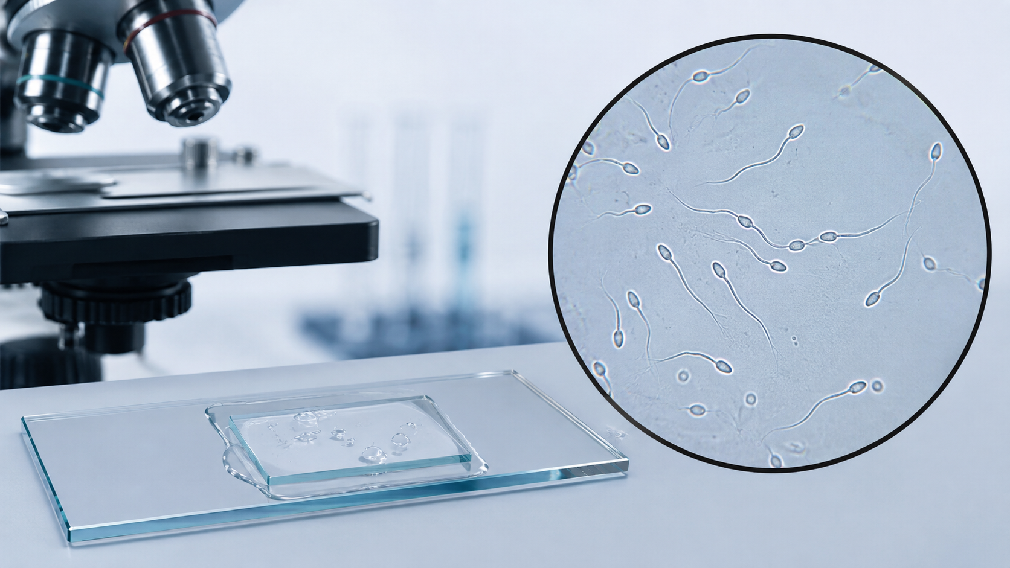
Step 3: Microscopic assessment
What is examined under the microscope?
10
Concentration and total number
Count sperm using a validated chamber and calculation method.
Motility
Classify sperm as progressive, non-progressive or immotile.
Vitality
Useful when motility is low to distinguish live from dead immotile sperm.
Morphology
Examine stained forms using defined criteria and report the proportion of normal forms.
Take-home: Microscopic assessment asks four core questions: how many, how they move, whether they are alive and how they are formed.
[1,2]
Inside Embryo by Aurion | insideembryo.com | Beginner teaching presentation
Notes:
Use the microscope image to make the process concrete. Concentration and total number estimate how many sperm are present. Motility describes how they move, not whether they are alive. Vitality is especially useful when many sperm are immotile, because some immotile sperm may still be living. Morphology evaluates structural form using stained preparations. These are related observations, but each answers a different biological question.

Slide 11
Simple process flowchart
From patient instruction to interpreted report
11
Input
Process
Outcome
1
2
3
4
5
6
7
Patient
instructions
Sample
collection
Reception and
identity check
Liquefaction +
macroscopic exam
Mixing and
aliquot preparation
Microscopic
evaluation
Report and
interpretation
Each step can affect the next one. A strong report depends on a strong workflow.
Take-home: Think of semen examination as a sequence: good instructions and good sample handling make the later numbers more trustworthy.
[1,2]
Inside Embryo by Aurion | insideembryo.com | Beginner teaching presentation
Notes:
Walk through the flowchart from left to right. The main teaching point is that semen analysis is a chain process. If the beginning of the chain is weak—for example incomplete collection or long transport delay—the later steps cannot completely correct it. This slide also helps learners distinguish input, process and outcome. Encourage them to think not only about what the final report says, but how the report was produced.

Slide 12
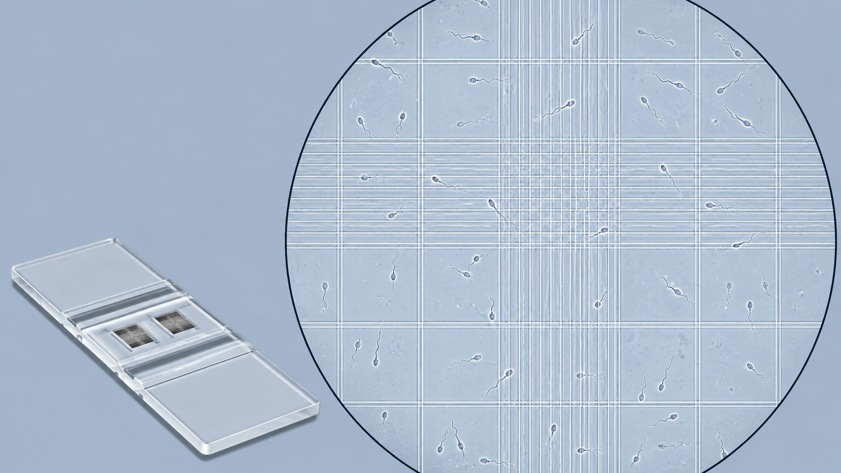
Core parameters and units
How to read the main report headings
12
Parameter | What it tells you | Common unit
Volume | Size of ejaculate | mL
Concentration | Sperm number per mL | 10⁶/mL
Total sperm number | Total sperm in whole ejaculate | 10⁶/ejaculate
Progressive motility | Forward-moving sperm | %
Total motility | All moving sperm | %
Vitality / morphology | Live sperm / normal forms | %
Take-home: Always read the unit and denominator before interpreting a parameter.
[1,2]
Inside Embryo by Aurion | insideembryo.com | Beginner teaching presentation
Notes:
This table helps learners decode report headings. Stress the difference between concentration and total sperm number: concentration is per millilitre, whereas total number refers to the entire ejaculate. Likewise, progressive motility is a subset of total motility. By learning the unit together with the parameter name, beginners make fewer interpretation errors. The image of the counting chamber reinforces that these numbers come from a standardised counting method, not guesswork.

Slide 13
Basic comparison: WHO 5th versus 6th edition
Similar purpose, updated emphasis
13
WHO 5th edition
WHO 6th edition
What happens
What happens
Introduced lower reference values from recent fathers.
Focused on standard routine semen analysis methods.
Often used as the reference framework for many current laboratories.
Updates methods and strengthens QA/QC emphasis.
Groups testing into basic, extended and advanced examination.
Encourages cautious use of reference values and more nuanced interpretation.
Selected lower reference values / useful values from fertile men
Parameter | WHO 5th edition | WHO 6th edition
Volume (mL) | 1.5 | 1.4
Concentration (10⁶/mL) | 15 | 16
Total motility (%) | 40 | 42
Progressive motility (%) | 32 | 30
Vitality (%) | 58 | 54
Normal morphology (%) | 4 | 4
Take-home: Reference values describe fertile-population distributions; they are not guarantees and should not be used as simple pass/fail labels.
[1–6]
Inside Embryo by Aurion | insideembryo.com | Beginner teaching presentation
Notes:
Use this slide to compare editions clearly without overwhelming the learner. The upper panels describe conceptual differences. The lower table shows selected semen values commonly discussed in teaching. Explain that the exact numbers are population-based reference points derived from fertile men. They help contextualise results, but fertility cannot be decided from a single threshold. This is one of the most important interpretive lessons in both editions.

Slide 14
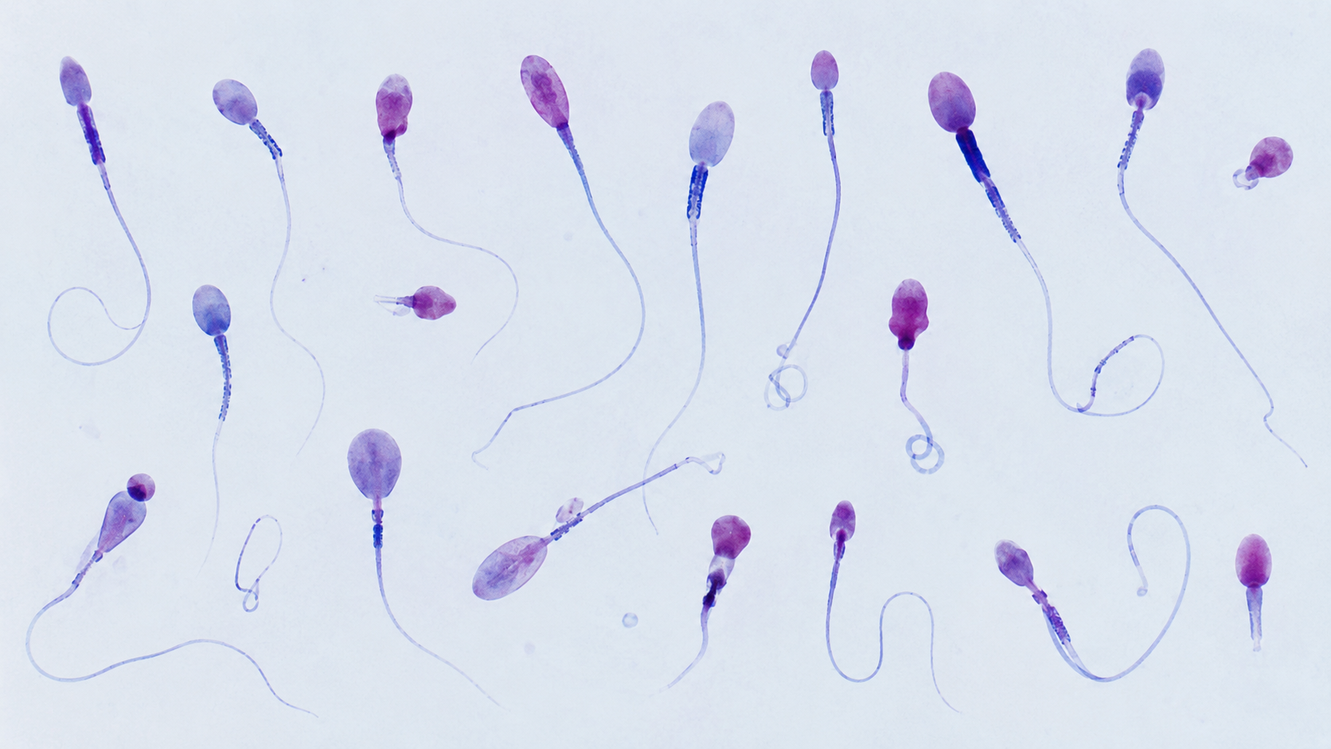
Important classifications
Movement, vitality and form are different classifications
14
Motility classes
Progressive, non-progressive and immotile describe movement.
Vitality
Live versus dead helps interpret low motility samples.
Morphology
Head, midpiece and tail features are examined on stained smears.
Normal vs abnormal forms
Abnormality patterns may affect description, but no single shape predicts fertility by itself.
Take-home: A sperm cell can be abnormal in form, immotile and still alive—these are separate observations.
[1,2,5]
Inside Embryo by Aurion | insideembryo.com | Beginner teaching presentation
Notes:
Many beginners assume that one label summarises sperm quality, but this is incorrect. Motility describes movement, vitality describes whether immotile sperm are alive, and morphology describes structural form. Show the image and explain that a sample may contain a mixture of typical and atypical forms. The purpose of classification is to describe observed features consistently, not to make simplistic all-or-none judgments about fertility.

Slide 15
Factors that influence interpretation
Semen results are affected by more than sperm alone
15
Laboratory method
Validated chambers, stains and QC improve consistency.
Collection completeness
Abstinence interval
Lost sample may falsely reduce the result.
Too short or too long may change volume and counts.
Final
report
Time and transport
Illness / fever
Delay or temperature change may reduce motility.
Recent systemic illness can alter semen temporarily.
Biological variation
Results vary over time, so repeat testing may be needed.
Take-home: Interpretation is multifactorial. A single semen value never tells the whole clinical story.
[1,7]
Inside Embryo by Aurion | insideembryo.com | Beginner teaching presentation
Notes:
This second mind map reinforces a crucial interpretive concept. Semen results are influenced by pre-analytical factors, biological variation and the quality of laboratory technique. Explain that a man may show temporary changes after fever or illness, and that an incomplete sample can falsely lower total sperm number. This is why WHO guidance and fertility care both recommend interpreting laboratory data within a broader clinical frame rather than in isolation.

Slide 16
Common misconceptions
Correcting beginner errors calmly and clearly
16
Myth: A normal semen report proves fertility.
Correction: No. Fertility also depends on female factors, timing, and biological function not captured by one test.
Myth: One abnormal result proves infertility.
Correction: No. Repeat testing and clinical context are important because semen varies over time.
Myth: Motility and vitality mean the same thing.
Correction: No. Motility is movement; vitality is whether sperm are alive.
Myth: Morphology alone predicts ART success.
Correction: No. It is one descriptor among many and should not be over-interpreted.
Myth: WHO values are pass/fail cut-offs.
Correction: No. They are reference distributions from fertile populations, not guarantees.
Take-home: Good semen analysis teaching avoids overstatement and keeps interpretation evidence-based.
[1,6,7]
Inside Embryo by Aurion | insideembryo.com | Beginner teaching presentation
Notes:
This is an excellent discussion slide. Pause after each myth and ask the class what they think before revealing the correction. Emphasise the theme of careful interpretation. Learners often overvalue single numbers or assume that normal morphology or motility guarantees reproductive success. Correct this by reminding them that semen analysis contributes important evidence, but fertility and ART outcomes are multifactorial and probabilistic rather than certain.

Slide 17

Practical clinical relevance
Where this topic appears in IVF and fertility care
17
Male partner
evaluation
Semen
examination
Report
review
Clinical
context
Management
planning
Results may prompt repeat testing, further male evaluation or lifestyle discussion.
In ART, findings help inform sperm preparation and the broader treatment plan.
The report must be integrated with female factors and couple history.
No semen parameter alone guarantees success or failure in IUI, IVF or ICSI.
Take-home: Clinicians and embryology teams use semen examination as one piece of the patient pathway, not as a standalone verdict.
[1,7]
Inside Embryo by Aurion | insideembryo.com | Beginner teaching presentation
Notes:
This slide connects laboratory science to real clinical practice. Explain that a semen report may lead to repeat testing, targeted male-factor evaluation, or discussion of the most suitable assisted-reproduction approach. However, management decisions are never based on semen parameters alone. Female factors, duration of infertility, age, and the goals of the couple all matter. This helps learners see why laboratory accuracy and communication are clinically important.

Slide 18
Key takeaways
Essential points to remember
18
1
Standardisation starts before microscopy.
2
Macroscopic and microscopic steps both matter.
3
Know the parameter, the unit and the denominator.
4
WHO 6th edition updates methods and interpretation structure.
5
Reference values guide interpretation but do not guarantee fertility.
6
Repeat testing and full clinical context are often necessary.
Take-home: If learners remember the workflow, the key terms and the limits of interpretation, they already have a strong beginner foundation.
[1,2,4]
Inside Embryo by Aurion | insideembryo.com | Beginner teaching presentation
Notes:
Use this slide as a recap and revision tool. The aim is reinforcement, not new information. You can invite learners to match each takeaway to an earlier slide—for example pre-analytical standardisation, key units, and the meaning of reference values. This helps move information from short-term memory into a clearer overall framework and prepares learners for the final knowledge check.

Slide 19
Knowledge check
Five quick questions for beginners
19
Question 1
1. Which test helps distinguish live immotile sperm from dead sperm?
Question 2
2. Which parameter is reported in mL rather than % or 10⁶/mL?
Question 3
3. True or false: one normal semen report proves fertility.
Question 4
4. WHO 6th edition groups testing into which three levels?
Question 5
5. Name one pre-analytical detail that must be documented clearly.
Take-home: Use the questions to check understanding of terms, workflow and interpretation limits.
Inside Embryo by Aurion | insideembryo.com | Beginner teaching presentation
Notes:
Suggested answers: 1) Vitality testing. 2) Volume. 3) False. A normal report does not prove fertility. 4) Basic, extended and advanced examination. 5) Acceptable answers include abstinence interval, collection time, completeness of collection, transport delay or sample identity. Use this slide interactively and encourage learners to explain why the answer is correct, not just state the word.

Slide 20
References and educational disclaimer
Authoritative sources used for this teaching deck
20
References
1. World Health Organization. WHO laboratory manual for the examination and processing of human semen. 6th ed. Geneva: WHO; 2021.
2. World Health Organization. WHO laboratory manual for the examination and processing of human semen. 5th ed. Geneva: WHO; 2010.
3. Cooper TG, Noonan E, von Eckardstein S, et al. World Health Organization reference values for human semen characteristics. Hum Reprod Update. 2010;16(3):231–245.
4. Campbell MJ, Lotti F, Baldi E, et al. Distribution of semen examination results 2020. Andrology. 2021;9(3):817–822.
5. Björndahl L, Barratt CLR, Mortimer D, et al. The sixth edition of the WHO Laboratory Manual. Fertil Steril. 2022;117(2):246–251.
6. Boitrelle F, Shah R, Saleh R, et al. The Sixth Edition of the WHO Manual: critical review and SWOT analysis. World J Mens Health. 2021;39(4):577–594.
7. AUA/ASRM guideline: Diagnosis and treatment of infertility in men. 2020; amended updates.
8. ISO 15189:2022 Medical laboratories — requirements for quality and competence.
Thank You
Inside Embryo by Aurion
This presentation is intended for scientific and educational use. It does not replace institutional protocols, formal professional training, clinical judgement or individual medical advice. ART outcomes are multifactorial and cannot be predicted from a single test, observation, embryo grade or laboratory parameter.
[1–8]
Inside Embryo by Aurion | insideembryo.com | Beginner teaching presentation
Notes:
This closing slide documents the main sources and reinforces the educational boundary of the presentation. When presenting live, briefly mention that WHO manuals should be read alongside local protocols, validated laboratory SOPs and quality requirements. The disclaimer is important because learners may otherwise over-apply single values or isolated laboratory observations. Encourage them to use this deck as a structured introduction and not as a substitute for supervised professional training.

